Slide 1
Vona du Toit
MODEL OF CREATIVE ABILITY
Current Status and Development
Dain van der Reyden
Nat dip OT, DipEd Voc, BA, LLM (Med Law)
School of Audiology, Occupational Therapy & Speech – Language Pathology
Dept. OT. University of Pretoria
September 2010

Slide 2
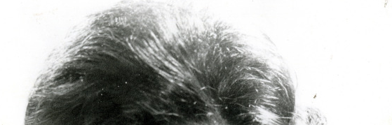
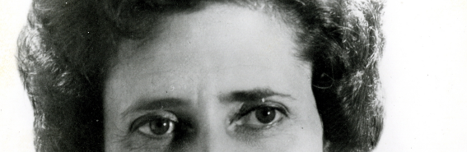
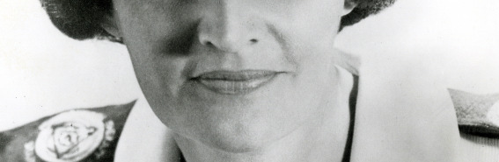
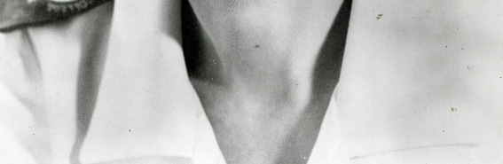

Slide 3
“Our Model”
Objectives of Presentation:
To give broad brush overview of developments over past 40 years – where it all started & how it developed
Look at current status and
Way forward – what now?

Slide 4
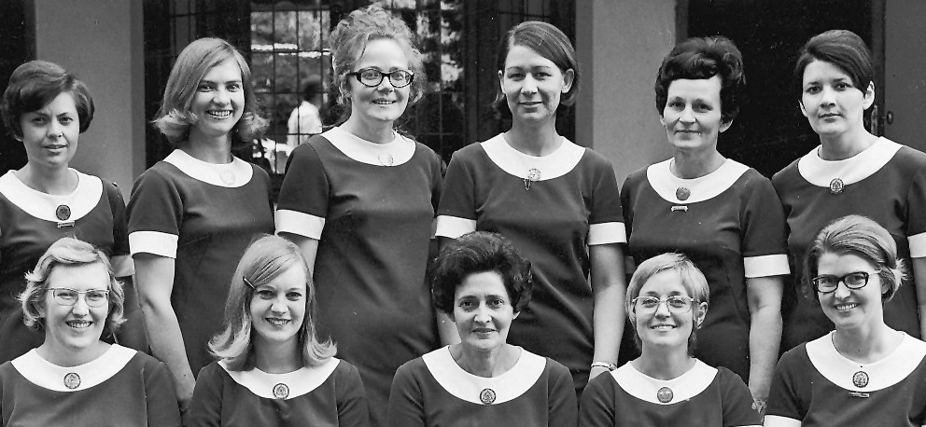
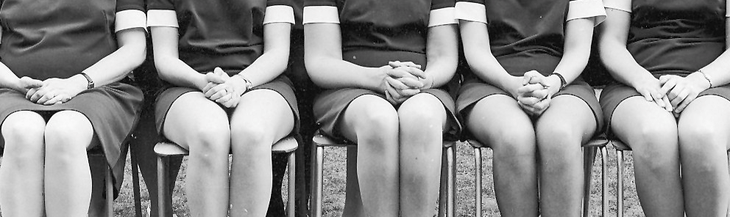
DvdReyden Pta 9/10

Slide 5
Where did it all start? What was happening at the time in healthcare, the profession and practice?
A brief overview of the situation during the 1960’s-70’s…

Slide 6
Health Care Context
Development & Application
MOCA
Professional &
Practitioner Context
Practice - Training - Regulation & Control
The Origins ... The Issues

Slide 7
Firstly, The Healthcare context – then…
Early 60’s and 70’s:
Gross discrepancy in levels of care for different sectors of population
Early stages of development of rehabilitation; OT services only available for +- 15 years
Polio epidemic impact
Leprosy
TB
Physical disability, including long term impact from WW2, also border wars in RSA
Institutionalised care for individuals with Mental Illness/intellectual impairment – common practice
Children with disabilities- some special schools, majority no input (assessment or treatment). No inclusive education
Missionary Hospital services providing limited services in out lying areas
Military Hospitals providing extensive health services (due to border wars)
Strong medical model approach

Slide 8
Secondly, the profession and practice of occupational Therapy
The 1960’s and 1970’s were characterised by:
Use of arts and crafts as therapy –use of weaving looms for every conceivable problem
through use of pedals, slings and springs; cane work for all hand, u/limb and ‘work’ problems;
also doing carpentry, metal work, cord knotting and leather work!!
Making of assistive devices and ‘primitive splints’
Domiciliary OT
Emergence of “specialised techniques- Bobath
Individualised approach; doing what’s “good”, providing opportunity to develop skills,
overcome disability
Practice in field of intellectual impairment viewed with suspicion
Research extremely limited
WFOT minimal standard stipulated 6 media of OT (including media graded to restore personal
management, leisure, socialisation)
Media graded to restore/develop creative ability leading to work capacity added to list after
inputs by Vona du Toit
Strong western medical model input, medical paternalism
Isolation due to apartheid system rejection, limited exchange information
Female dominated profession (OWLS)

Slide 9
Training in RSA – Then and now…
OT training commenced 1945, 3 year diploma - University of Witwatersrand
Training done by “imported British OT’s”
Now 8 university training centres, all 4 year honours level degrees, M’s & PhD's
1965 < 200 OT’s in RSA; 2009 > 3500
At time of “emergence” of model very few OT departments, OT not yet established or in its infancy (single handed depts.), few clinical training opportunities
Strong medical model, paternalistic approach to training (institutional)
Strong crafts focus – weaving, leatherwork, sewing etc…OT’s highly skilled

Slide 10
Regulation and control, who pulled the strings?
1960’s…
Registers available at SAMDC, but no statutory registration (voluntary until 1992)
Registered with SA Medical and Dental Council to practice
First Professional Board for occupational therapy established +- 1973 (no powers)
Health profession act geared to medical and dental profession- all the rest ‘lumped together’ as Para-medical/ supplementary health services with no decision making/ independence
all treatment only with medical referral/prescription
always represented by medical profession at governmental level
1984 Registers for OT assistants and technicians introduced
1992 Compulsory Registration
1994 Independent Boards - HPCSA
DvdReyden Pta 9/10

Slide 11
What was Vona’s point of departure? What were her foundational ideas, values and beliefs?
Firstly of person (“man”)
And Secondly of occupational Therapy
Vona believed that:
Each person is unique, the indivisible totally of psyche, spirit and soma
Each person indivisible part of his/her world and the world an indivisible part of the self- continuous interaction dialogue
Person spiritually needs purposeful activity and specifically to work, contribute to his/her world
Interaction with the “world” integral to humanity, is stimulated by the environment (what's happening in and around the individual)
Development take place on a continuum of identification and fulfillment of own needs and those of ever widening environment, culminating in responsibility to fellow man

Slide 12
PARTICIPATION IN PURPOSFUL ACTIVITY (=OCCUPATION) will contribute to recovery, growth and development
Relatedness for other persons (fellow man) assign meaning to life expressed strong sense of responsibility to fellow man
Person takes responsibility for what becomes own reality; decisions must originate from person self
“doing” (action) is reflective of “being” (volitional state)
Repeatedly spoke about “freedom towards responsibility”, implying that ability actualised goes hand in hand with responsibility (result excessive responsibility to profession)
She believed that the ultimate aim of any ‘relatedness’ to people, objects, situations was to experience an I-Thou ‘Moment’ which implied a total ‘one-ness’ and identification with absorption into the moment/activity/person. The “I-Thou relatedness” should also be sought in treatment

Slide 13
Purposeful activity (occupation), can and will influence state of health and well being
The ‘spiritual’ component must be acknowledged in treatment - seen as ‘catalyst’ to optimal holistic functioning of individual
All treatment should strive to attainment of ever increasing maximal, total participation in life. INSPIRE participation
Facilitation of contribution to the ‘world’
Hierarchy OT focus of treatment graded from attention to components (symptoms)
Basic ADL Full participation in life and especially preparedness for occupation in work/productivity area

Slide 14
OT’s must apply self (vitality, energy, sensitivity, responsiveness, INITATIVE) to all intervention, not just their skill and knowledge
OT must facilitate participation in purposeful activity through adaption of variables (environment, activity, handling, presentation)
OT unique for each individual
  never just select an activity, apply a technique
  activity must be inextricable part of role and tasks of individual
  individual must indicate, cannot be ‘done to’ person; must ‘do with’
Vona’s beliefs and values about the person and our profession
are integral to the MOCA, impossible to view separately

Slide 15
The Model - the past 40 years:
Going back to the model’s inception and early years, some basics:
Levels of volition first presented in 1965
The different stages of “Psychical recovery” (1970) initially viewed as scale of measurement of ‘doing level’ of person
Stages of volition (being) initially defined as destructive action, incidental creative action, explorative, imitative, personal creative and product centered responses
Later linked to stages of action (doing) and interrelatedness established
Each stage represents “fluidity” – characteristics of previous as well as emerging stages, no absolute linear demarcation
Each ‘characteristic’ grows in a spiral, ever increasing vertical and horizontal fashion & e.g., sense of self
Diagnosis less significant at lower levels
Occurs in 3 cycles (preschool; school age and adult hood)
Attainment of participation and eventual mastery in occupation is fundamental to progression to higher level/next stage

Slide 16
Terminology changed from stages of “psychical recovery” to stages of volition (being) and action(doing) (1972). Term creative ability used as overarching term
Definition still somewhat ‘problematic’ but significant components include:
  Creative participation reflects the doing component, and creative ability, the actualised creative potential
  Maximal effort and involvement
  Functioning freely without anxiety
  “Doing” is evidence of relational contact with- persons, objects/materials, environment/situations
Further terminology change proposed (for alternative use) Pretorius (1976) – Indicates an overall performance level
Psychical recovery Creative Participation
Self Differentiation Unconstructive level
Self Presentation Constructive level
Passive participation Norm awareness
Imitative participation Norm compliance
Active participation Norm transcendence

Slide 17
Grouping of stages into 3 groups (de Witt)
PREPARATION FOR
CONSTRUCTIVE ACTION
BEHAVIOUR AND SKILL
DEVELOPMENT FOR NORM
COMPLIANCY
BEHAVIOUR AND SKILL
DEVELOPMENT FOR SELF
ACTUALISATION
Group 1-stages
Tone and self differentiation
Group 2-stages
Self presentation
Passive participation
Imitative participation
Group 3-stages
Active participation
Competitive participation
Contribution
Competitive contribution
This grouping assists with directing focus of intervention

Slide 18
The past 40 years!
Some theoretical ‘premises’ (conceptual issues as formulated by Vona du Toit, but modified through practice
Theoretical ‘premises’ as proposed by Vona du Toit, and modified through
practice:
A “perfectly therapeutic session” can (as proposed) enable movement to a higher level BUT found to be only sustained through an environment (structure, handling and on going activity), in which principles are consistently applied, therefore a more “full day” is needed, repetition and ongoing facilitation (especially in mental health)
Destructive response as described at tone and self differentiation is not “inevitable” often due to inability to identify/verbalise painful/uncomfortable threatening feelings/situation/person
du Plessis believed that in the case of a person with a severe physical injury/disability the newly differentiated “ quantitive self” gave rise to frustration, aggression, excessive anxiety and destructive behaviour and
withdrawal. Only with acceptance of the ‘new’ self (e.g. person with
quadriplegia) does individual go into stage of self presentation

Slide 19
Model well suited to “generalisation” and use with groups
Group can be managed through application of principles (i.e. Structure, activity selection handling, presentation) as applicable to majority or subgroups within group
Effective application as screening tool to determine overall level of performance (25-1000 individuals)
Model very effectively used to do needs analysis, plan and implement cost effective services/programmes for entire populations (e.g. Home for aged)
Model may, with training by OT, be applied effectively by OTA, OTT, Nurse, C.Hw, CRW
Motivation usually described in model as a positive is seen to govern action, not adequately acknowledged that action may be governed by various other factors such as external pressure, fear – therefore not directly motivated
Action may also be limited by physical disability, poverty, cultural expectations and thus do not express motivational level

Slide 20
“Maximal effort" required to bring about a change in level/stage does not often occur consistently or even spontaneously (child individual with mental illness ). Maximal facilitation required; gains need to be sustained to be meaningful (reinforced)
Task concept- a very central concept to understanding of the model and has been further researched by de Witt, the task is described as having 2 components:
  Understanding activity as a whole
  Indentifying with task (sense of engagement and product)
de Witt details 5 interacting aspects which are essential for productive action. These are:
  Task selection (choice)
  Task execution (process and motivation to sustain)
  Task completion (awareness completion)
  Task evaluation (?quality, belief in self)
  Task satisfaction (emotional Reponses to engagement/ end product)
(Type of detail absent from original publications)
√
X

Slide 21
The past 40 years!
Practical developments in the APPLICATION OF THE MODEL:
Application first with children with Cerebral Palsy and individuals with chronic mental illness, focus entirely individual based
Also intellectual impairment acute and medium term mental illness; persons with ABI
Considered in intervention of persons with general physical disorders- less acknowledged but adds rich dimension
Application in school and psychiatric hospital setting
Also community settings, clinics, private practice, ward programmes by nurses

Slide 22
Hands on application by OT
Now also OTA, OTT’s, nurses, community workers (with training to use simplified version)
New/more/way of thinking (1965) i.e. To apply a theory on the one hand proposed by du Toit as ‘new approach' and just accepting the fundamental theoretical constructs and application as a “unquestionable fact” relevant for all intervention
Various ‘models’ and approaches now being applied by OT’s,
Use eclectic approach
Do critical analyses and review of models need for validity and reliability testing of all models and approaches
application in evidence based practice

Slide 23
From 1977 onwards…
Major shift – individual to group/population application
Use MOCA levels to screen, classify, group and initiate intervention (OT planning, supervision, training-assistant nurses implementation) for total population
Develop systems’ further effective management of large numbers in daily programmes for all residents

Slide 24
1978:
Develop analytical survey (MOCA as basis) as:
  Screening instrument (25-2000 individuals)
  Evaluation of current programme
  Planning for ‘new’ programme
  Revitalisation of ongoing programmes
Develop short (2min) screening instrument (OT and nursing staff).

Slide 25
1979:
  Programmes introduced for large numbers of children with intellectual impairment (profound and severe impairment levels mostly)
  (Pretorius, Van Ginkel, Varney, Zietsman and others)
Level of intellectual impairment shows strong correlation with CA levels
  Profound Tone/Self differentiation
  Severe Self presentation
  Moderate Passive participation
  Mild Imitative participation
Programme planned again using level of CA to offer sensory stimulation concept training, self care training, exposure to environment, interpersonal contact and pre academic training

Slide 26
Training of auxiliary staff to implement programmes based on MOCA (major departure Vona du Toit’s thinking)
OT assistants and technicians run various groups with patents functioning at different levels based on carefully planned protocols for levels and each group
OT supervision, review and revitalisation
Nursing staff trained to apply basic principles
(details Crouch and Alers 1,2 &3rd edition)

Slide 27
1980’s -1990’s and currently: -
On going application with individuals and groups “Smith Mitchell“(later Life Care, now government facilities) programme adopted nationally used + 30 years
Programme refined & staff training maximised, systems and protocols in place
  Thousands of OT’s apply model as part of day to day practice, often alternatively with MOHO
  Minimal recording and reporting with isolated research projects conducted
  Application and enthusiastic development in UK (Sherwood)
  Research limited but showing positive signs (Casteleijn Sherwood, de Witt, Jansen, Coetzee, Rice, du Plessis, Schultz, Zietsman, Holsten & Lingam)

Slide 28
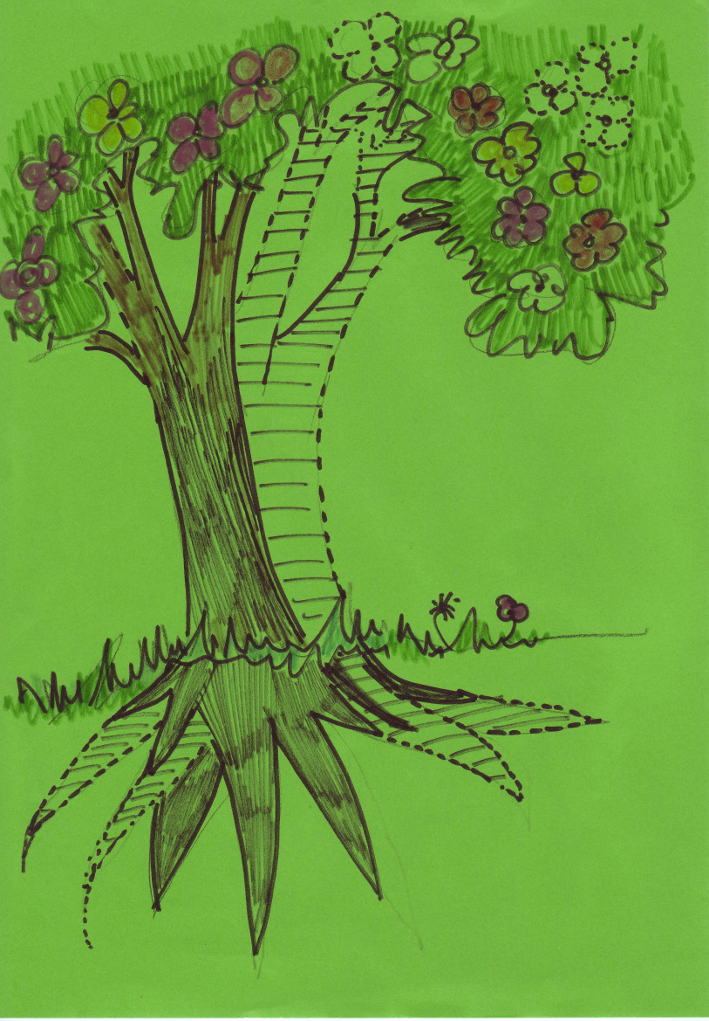
Where are we now? Diagrammatic Representation – Status/State of Model
FRUITS
TRUNK
Research
Du Toit Publications
Documented Practice
Recorded Foundational Theory
ROOTS
Academic Training
Clinical Experience
Oral History/ Clinical Training

Slide 29
Firstly What Have We Got?
A model which tells us:
What motivation is and how it can be measured and facilitated
About interrelatedness of volition (being) and action (doing)
The nature of task performance and the critical significance of “mastery/ success”
About manifestation of ability and performance (development, recovery, regression, deterioration) at sequential interdependent levels
Significance of participation in purposeful activity (human occupation)
Improvement/ development / recovery is always possible if a ‘challenge’ is offered at appropriate level in appropriate way
A model which gives us: a therapeutic and rehabilitative approach from a constructive (low) to competitive contribution high level of performance and shows us how to effectively deal with persons at different levels of motivation/ action
A wonderful model by virtue of its unquestionable clinically proven value to assess and effect substantial change in levels of performance of individual/groups

Slide 30
Highly experienced, committed practitioners, efficiently and effectively using the model. Based on collective memory of the model
Extensive experience, clinical models and records. As well as papers presented, teaching material spanning 40 years, not recorded
A model which makes OT’s the only professional group able to actively provide effective intervention to individuals functioning at low levels
Training at different levels/detail, at 6/8 training centres; critical comparative analysis with other models E.g. MOHO
Reductionist but critically viable application of model in management of large numbers
Literature/ theory (hard and electronic copies) too limited to substantiate existence of a theoretical model but unquestionably an effective practice model
Valuable tool for use by other professional groups (nurses –ward programmes)
Increasing International Interest – UK, Japan, USA

Slide 31
Secondly – what does a more analytical approach show us?
A Quick ‘SWOT ANALYSIS’ (a)
STRENGTHS
WEAKNESSES
INTERNAL
Established as a ‘CLINICAL/ PRACTICE MODEL’
More than 3,000 OT’s applying model in RSA, value unquestionable
Extensive clinical experience and expertise, clinical models of application, fanatical commitment
Established Training Programmes, 6/8 T.C.
Consumer friendly application (with training)
Culture, age, diagnosis, institutional and community friendly
Effective and efficient in different practice areas, all levels of performance
Effective individuals, groups, large numbers, cost effective
Vona and Marie du Toit Foundation as guardians
Recorded and published theory not substantial enough for status as model
Queries about ‘validity’ as a theoretical model (model in progress)
Foundational theory base not sufficiently recorded
Clinical models/experience not sufficiently recorded
Inconsistent use of terminology, definition, concepts, assessment and application
Research/literature/publications limited (10 articles, 3 book chapters, 3xM’s, 4 PhD’s, ‘die boekie’, few presentations)
No authoritative textbook
Lack national collaboration and sharing
Intellectual property not claimed/clarified

Slide 32
A Quick ‘SWOT ANALYSIS’ (b)
OPPORTUNITIES
THREATS
Reduced to a technique to screen and group clients
Divergent developments nationally and internationally, not consistent with fundamental constructs_ ? New Model
Inappropriate use by other professional groups
Stagnation, development not in keeping with international trends
EXTERNAL
Development of model with strong theoretical constructs, evidence based validity
RSA-UK Collaboration
Combined resources and energy – revitalise
Research project (International)
Evidence based practice requirements
CPD requirements
UK & Japanese developments
2009, 2010 UK Conferences

Slide 33
Why?
Vona’s personal conviction of the “truth” of the model
Unquestioning, unwavering belief in what she said
Oral and practical carry over of knowledge and skill – 1st & 2nd generation trained by Vona are still around
Internalisation of principles and procedures as “personal property” (“my model”)
Little or no debate/questioning on the local/regional/national level
Little or no sharing of experience/knowledge between therapists/ facilities regionally or nationally (few workshops, 1994 Conference) (Other??)
Individualistic interpretation & adaptation
Application without question or reflection, reductionistic application

Slide 34
Attitudes of:
  “We know it works”
  “We can’t manage without it”
  “It’s as natural to us as breathing”
  “It comes automatically”
  “We’ve been applying it for years”
  Poorly recorded theoretical constructs
  Differences in interpretation of concepts
  Insufficient detail to make model accessible for non-SA trained practitioners
  Lack of guardianship; uncertainty about intellectual property issues
  Limited current direction & directives for assessment and intervention

Slide 35
Objective of Presentation
The way forward – What now?
Developments:
Establishment of Vona & Marie du Toit Foundation Interest Group
Initial Group: Estelle Shipman Pat de Witt
Daleen Casteleijn Kobie Zietsman
Carole Pretorius Rolyn du Plessis;
Matty Van Niekerk Elizabeth Holsten
Annemie du Plessis Dain van der Reyden

Slide 36

Tasks of the Interest Group...
Getting the in a Row!
  Guardianship of the model
  Compilation of a glossary of terms & concepts
  Write-up of theoretical constructs
  Clarification and expansion of information on CA as assessment (philosophy, principles and procedures)
  Clarification and expansion on information on implementation (philosophy, principles, procedures and programmes)
  Review and “coordination” of training (will meet in 2nd half of 2010)
  SAJOT – Special Edition
  Guide research
  Compilation of a textbook on the model
  Annual Workshop (2011 – Wits)
  Increased involvement with ICAN (International CA network) and MCAIG (Mode of CA Interest Group) webpage
  Increased international cooperation (RSA-UK- Japanese practitioner interaction)

Slide 37

The Name of the Model
Psychical Recovery?
Stages of Volition and Action?
Creative Participation?
Creative Ability
Vona du Toit Model of Creative Ability
(VdTMoCA? VdTMCA?)
Intellectual Property & Copyright

Slide 38
Consensus reached at Colloquium (Jobs?)
We have a wonderful practice model which we need to “cherish”
In depth study & analysis of theoretical & philosophical constructs to justify status as a model
Continue with clarification of Terminology, concepts (write down what seems obvious!)
Further identify & clarify concepts that have not been formulated e.g. manifestation of levels at different life cycles
Look at “newer” terminology – (Occupation-)? Relevant? Need to adapt?
“Monitor” training (share)

Slide 39
Assessment
Not a tool in itself, rather interpretation & reflection of performance (routine & novel tasks)
  Need to standardise form to use (table format? expand?)
  Record OPA – each OPA to be described i.t.o level
  Emphasis on need to do assessment (comprehensive)
  Query – do we need to standardise the assessment? Is it possible?

Slide 40
Implementation
Context of client to be given much attention
Investigate & record use of model in promotive & preventative programmes
Make application more accessible to non-SA trained OT’s – descriptors needed/ protocols for management
Promote value for intervention at low levels of functions
Clarify & differentiate application different practice areas (physical/ psych/ paeds)

Slide 41
General
Establish a well-functioning community of practice – operationalise
Facilitate clinical recording & reporting
Market the model – use the name of the model - give recognition/acknowledge
Use to promote OT contribution
Reconsider use by other team members (watered down versions?
Reconsider issue of ‘norms’ – whose norms are we using anyway?
Do comparative analysis with other models (MOHO, Reed, Allan)
Increase National & International collaboration (Wits 2011)

Slide 42
Research & Publication
International Research Plan & funding Proposal (M’s & PhD’s)
Publication of Research Projects (Dedicated SAJOT edition?)
Compile a textbook

Slide 43
THANK YOU!
Open for Discussion…

