Slide 1
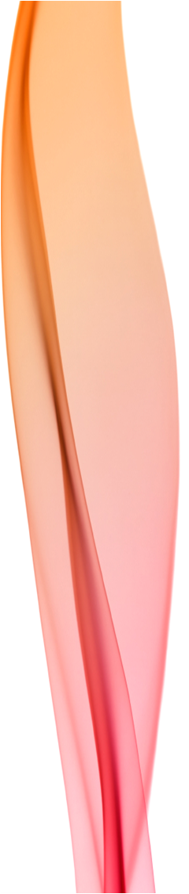
An approach for addressing the memories and concept of client who has suffered traumatic experiences
Hizen Psychiatric Medical Centre
Yoshiko Nakano
Presentation at the International VdT Model of Creative Ability conference, 2010

Slide 2
History
High school –reduced attention
University – difficulties
natural disaster
dropped out of uni
Personality changed; ‘lazy’
Schizophrenia? - Mental health day care
Worked for 3 years – reprimanded / beaten
– withdrew socially
Father died --- drinking, lazy, violence, hallucinations?
Admitted 2 years ago
? Self-presentation –
Passive participation

Slide 3
Summary
Self-differentiation-Self-presentation
Self-differentiation
problems understanding his environment
difficulty recognizing stress and quick to feel victimized or threatened - lashes out as a result
Self harming to release stress
Cannot understand jokes – focuses on literal meaning of words in conversation
Likes cigarettes alcohol, the piano, table tennis, shogi (similar to chess) and Tai Chi
Failures in life have resulted in a very low self esteem: especially stands out

Slide 4
Difficulty with communication but adequate enough to attend OT sessions
Unpredictable violence
Confusion re: insignificant things

Slide 5
Deterioration of other patients
Ward move
Unstable, self-harming - deteriorated

Slide 6
Personal management
Meals: Sometimes refuses to eat
Tooth brushing: After every meal
Face washing: Sometimes
Hand washing: When needed
Bathing: Less than once a week – ‘tiring’
Dressing: 3 layers on top and bottom. Removes layers for ease of movement
Laundry: Sometimes, but is staff responsibility
Cleaning and Organization: Fastidious, Obsessed with location of objects; rearranges personal objects.
Staff clean his room.
Medication: Staff's responsibility
Money: Places orders for the hospital store by himself
Schedule: Sometimes remembers his appointments but often forgets

Slide 7
Social ability
‘Better days/times’
acceptable behaviour
Aware of others; listens, waits turn to speak; short conversation with eye contact
Other times
Unable to express himself verbally
Focuses on literal meaning of words and relates them directly to himself and his life
Can’t understand the meaning of what is said
Dwells on words and strays from the subject
Difficulty answering simple questions
Stress expressed with facial expression and body

Slide 8
Work ability
Unable to understand meaning of step: written instructions
Difficulty understanding: some objects
Obsessed with words used in the sentences; difficult to grasp the whole meaning
Difficulty with body coordination: very particular about the way he moves
Becomes fatigued: help with 1-2 step tasks
Slow but precise and careful
20 minutes of body work - rarely distracted
Playing the piano

Slide 9
Work ability
Connects ‘creative activities’ with the word "work" and failure
"isn't good enough", "I will get beaten" or
“it isn't good enough to sell"
Table-tennis: “if we were keeping score who would be winning?"
If we answer that he would be in the lead, he says that he has lost
Doesn't reflect on the positive aspects of his game but always reflects on the negative aspects

Slide 10
Use of Free Time
Lying on bed with curtains closed
Reorganising belongings
Tearing plastic / paper
Tai Chi
Smoking = most relaxed

Slide 11
Control of emotion
Violent towards people x 2
Sudden
Inconsistent explanation
Shadow boxing
Hits wall and hurts self; kicks doors
? Flashbacks / auditory hallucinations
Stress / irritation
Expresses desire to drink alcohol

Slide 12
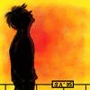
Problems
1. Using verbal and written communication
Unable to process information quickly
Obsesses with literal meanings of words
Violence – outwards and self-harming
Poor stress management
Emotion control / hallucinations?
Difficult to discuss violent actions
Connects with past bullying; unable to stay focused on discussion of his actions in the here and now
Self-defensive: feels threatened

Slide 13
Problems
3. Negative thinking
Difficulty with evaluation of feelings
Misunderstands the world: acts defensively
Talking about problem with alcohol results in him thinking about drinking
Associates ‘discharge’ with work
Environmental/situational changes are stressful

Slide 14
Main aims
Understand current state
Express physical feelings/emotion
Identify when stressed
Express / manage stress non-violently
Understand effect of actions on others
Communicate
Relate to others as non-threatening
Develop positive sense of self
Long term goals
Live at home
Integrate / relate to community
Work

Slide 15
Concept training
Dealing with physical sensations
Daily Routine
Approaching emotions through physical sensations
Using common experiences to discover common expressions
Starting with things John likes / interested in
Reality orientation
Interact with John receptively, using his actions and words resulting from his interests and initiative.

Slide 16
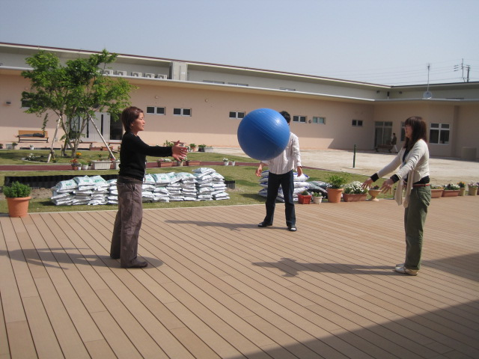
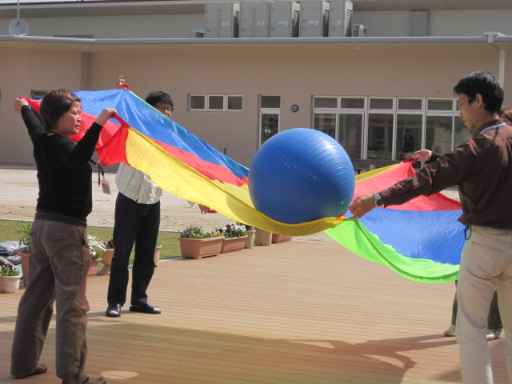
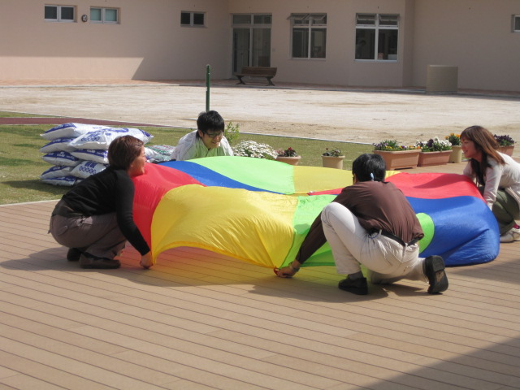
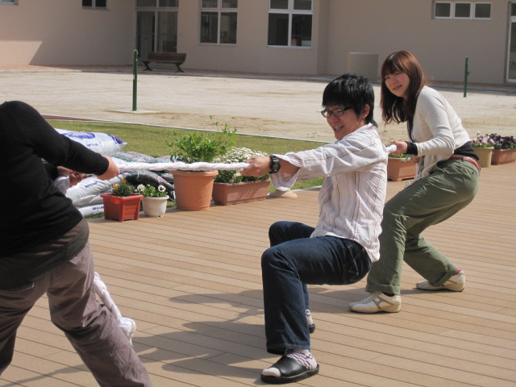
Body Work

Slide 17
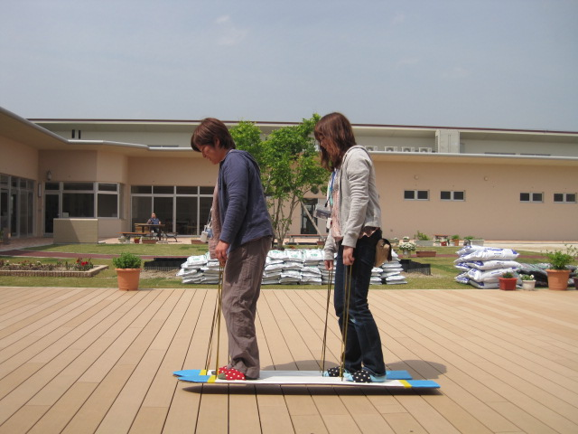
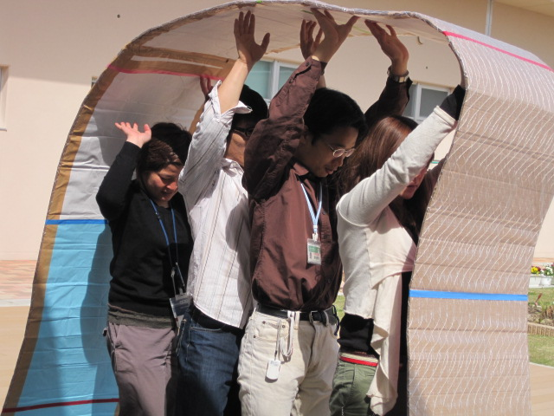
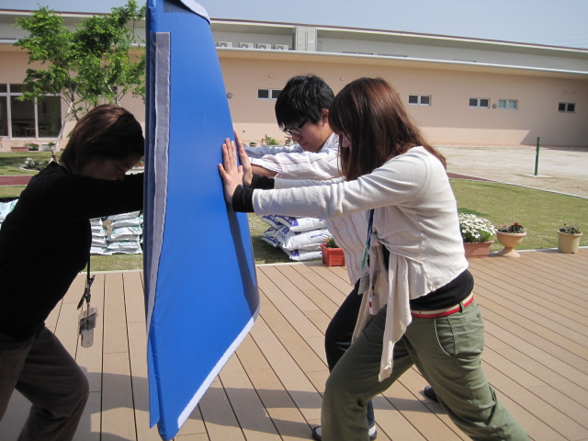
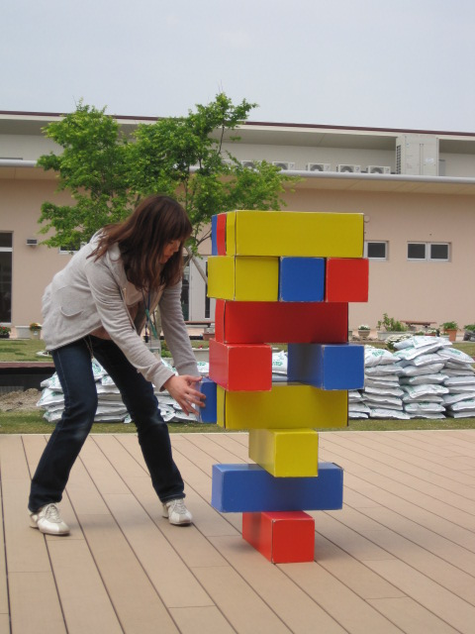

Slide 18
Physical Change Survey
Breathing
slow heavy
Body temp
cold warm
Fatigue
none tired
Body Heaviness
light heavy
“Emotional fatigue (stress) has gone. I feel refreshed.”

Slide 19
Physical Change Survey
Breathing
slow heavy
Body temp
cold warm
Fatigue
none tired
Body Heaviness
light heavy
Smoking is bad for my body
Different parts of body: confused
Individual body parts in weight

Slide 20
Total input
Body work
Table tennis
Piano
Weekly CP, Nursing input

Slide 21
Plan
Improve communication particularly when violent impulses increase
Reduce negative way he relates to the world and himself - increase pleasurable / positive experiences of his actions / of himself
He is close to having a common understanding with staff of the words “tired” “irritated” and “stress”; linking body work to stress release
Develop strategies for managing/expressing stress/emotion
Increase understanding that noises and people are not a personal threat; no need to act in self-defense.

Slide 22

We need to develop an environment where John feels safe: express himself in his own way without fear of making mistakes -where he can make many discoveries about himself.
Build up the number of experiences of having a positive effect on his environment to develop an affirmative view of himself.
One of the biggest roles for me is to create the kind of communication and interaction
needed to achieve these goals.

Slide 23

plan
problems
1. Using verbal and written communication
- Unable to process information quickly / memory?
- Literal meanings of words
2. Violence + self-harming
- Poor stress management + emotion control hallucinations?
Negative thinking / self esteem
Misunderstands the world: acts defensively
5. Talking about problem with alcohol results in him thinking about drinking
6. Associates ‘discharge’ with work
7. Environmental/situational changes are stressful
Develop an environment
where John feels safe:
Express himself in his own
way without fear of making
mistakes - make many
discoveries about
himself.
Build up the number of
experiences of having a
positive effect on his
environment to develop an
affirmative view of himself.
Develop communication:
common words /understanding

