Slide 1
‘Beautifully Disparate -
From Total Destruction to a Beautiful Goose’
Applying The VdT Model of Creative Ability to a patient with Complex Personality Disorder
Louise Jeffries
Senior Occupational Therapist
St.Andrews Healthcare
International VdT MoCA Conference June 2013
Notes:
I’ve worked with people with a personality disorder for 16 years, mainly males but females as well and I currently work at WWH, SAH in a medium secure unit on a ward for males of a working age.
I am going to talk about a new patient admitted to the ward, who initially portrayed a confusing picture when trying to assess his level of creative ability and sent me in to a state of turmoil. But through much reflection it has been an invaluable learning experience.
Although this experience has given me more knowledge and insight in to the model, I am still at a learning stage, so it gives me great pleasure to have the presence of Wendy and Dain Van Der Reyden to assist us in discussions and share their expertise.

Slide 2
Introduce the interactive activity
Notes:
You are going to come on a journey with me through ‘waves of change ‘
On the flip chart is a series of waves which represent each part of the journey.
At the end of each stage I shall ask some of you to place markers in the waves at the level of creative ability you think the patient is functioning at
I know it’s a very false situation with little information due to time, but it should generate some discussion

Slide 3
Initial impression
Very tall, muscular man, had a presence
Short hair, clean shaven and well kempt
Appropriately dressed
He greeted me and was articulate
He appreciated being in hospital
He was interacting with staff and patients
He was knowledgeable and creative
He had aspirations to work self employed
He was keen to engage with Occupational Therapy
Notes:
Stage 1 - read through
Add – during the handover it was explained that he was very much in to the New Scientist, he was knowledgeable in ecology, physiology, biology, economics
Ask the group to place a fish in the first wave to indicate the perceived level of creative ability - 3-4 people

Slide 4
Initial assessments
Initial interview – 45 minutes
Task assessments – cherry pie, decorating a box (2:1 & in a group)
Drinks in the café – (me & care coordinator)
Notes:
Stage 2 - Initial interview – read from separate sheet
Ask the group to place a starfish on the next wave
Stage 3 - Task assessments – read from separate sheet
Ask the group to place a pebble on the next wave
Stage 4 – Café – read from separate sheet
Ask the group to place a shell on the next wave

Slide 5
His project
He wanted to make a replica of a pattern he had created on a box with match sticks some time ago
He started by making a sanding board and then began to sand each stick to ensure a straight edge
He then methodically stuck them in diagonal patterns to a wooden board
Notes:
Having seen him create a perfect cherry pie and an amazing box I thought he would be able to complete this but he couldn’t, he struggled, couldn’t complete it and ultimately over time he destroyed it.
This left me somewhat confused

Slide 6
And then the destruction started
Notes:
And it was major. We didn’t know how to manage him or contain him and he sent the team in to chaos for a while.

Slide 7
He destroyed………………..
Materials
Objects
People
Situations
Notes:
Materials – used printing ink to paint his speakers which didn’t dry, (in his bedroom) He ripped linen bags to make a kite, he tore his clothes
Objects – he destroyed his speakers, electrical equipment, his door frame by using it as a tool, everything he tried to make in therapy sessions he destroyed
People – he was aggressive & violent towards others
Situations – he was disruptive in groups, dominate the community mtg, be intimidating as a means to manipulate the situation, he stormed out of ward round
He also harmed himself severely

Slide 8
Other observations….
Personal management
Social ability
Work ability
Use of free time
Notes:
Personal management – upon glancing in his room it looked neat and tidy, but closer inspection – toilet/shower room needed a deep clean, the sink stained with ink. The door frame damaged by him using it as a tool to cut/break things. Bed was tidy but sheets were dirty. The paint had been removed from walls in his attempts to stick things to them. There was a bag of wet clothes stuffed in his wardrobe with few, damaged clothes.
Social ability – he became destructive if staff had to say ‘no’ to him, he would intimidate, talk constantly about paranoid ideas or physical ailments, talk over people, disruptive in group situations, didn’t trust anyone, dismissed people, aggressive and violent towards others
Work ability – contained within the ward environment and when he was given some access off ward, his behaviour deteriorated. He had conscious interaction with materials and objects but would destroy them and could only sustain this for short periods. Rapidly shift from one activity to another, leaving a trail of destruction.
Use of free time – required much effort and input from staff to contain him unless highly structured.

Slide 9
And then the goose helped us make sense of it all
Notes:
We held a party and the inter-ward competition was to make an ice sculpture.
It started as an organised project, thinking of an idea, drawing a design, discussing how to build the main structure, it was a group project which he did not engage with.
However once the main body had been constructed he took over the art room which was once a very clean and tidy space.
We smashed polystyrene blocks, mixed it with glue and toilet paper, we made buckets of paper Mache which covered the goose, the room and the people in it.
He presented himself very differently. He was able to maintain effort and initiative for longer, he seemed to enjoy himself, he laughed, he showed some awareness of others – he acknowledged that he had painted them, he shared his thoughts, he was enthusiastic. His interactions were more focused on the task and he was more aware of the therapist, he initiated contact.

Slide 10
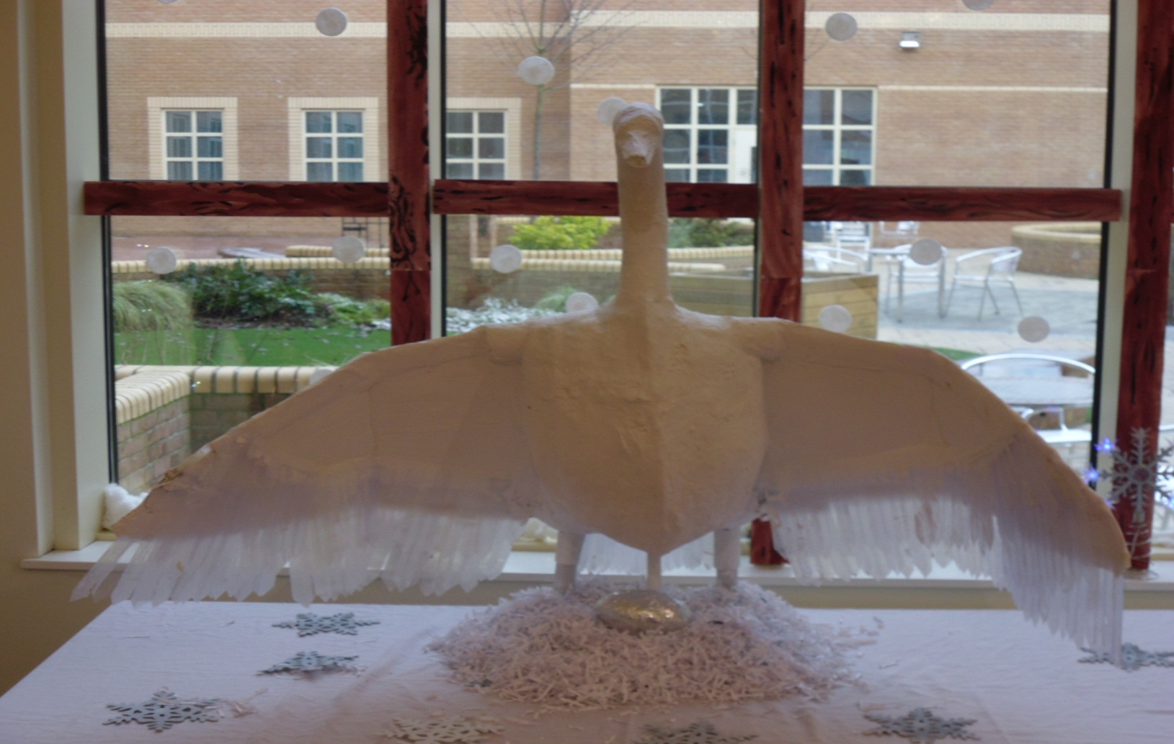
‘
‘Creative Ability is the ability to present oneself freely, without anxiety, limitations or inhibitions’
Notes:
Part of this success was that we had by chance found an activity which suited his level of creative ability.
The success was also down to the therapists handling, allowing him to be him, allowing him to make a mess and not be judged, we remained calm despite the chaos, we showed approval, we contained him safely.
The task encouraged movement, awareness of the impact of his body on materials., it allowed destruction.
We used the appropriate tools in the appropriate environment
Most importantly it was fun – something severely lacking in his life
At one point the therapists stood back and watched him and looked at each other as if to say “we’ve done it!”
I realised that previously I had allowed him to choose activities that he was unable to do – I should have been more prescriptive and selected more appropriate tasks but in all honesty I didn’t know how because of his disparate presentation.

Slide 11
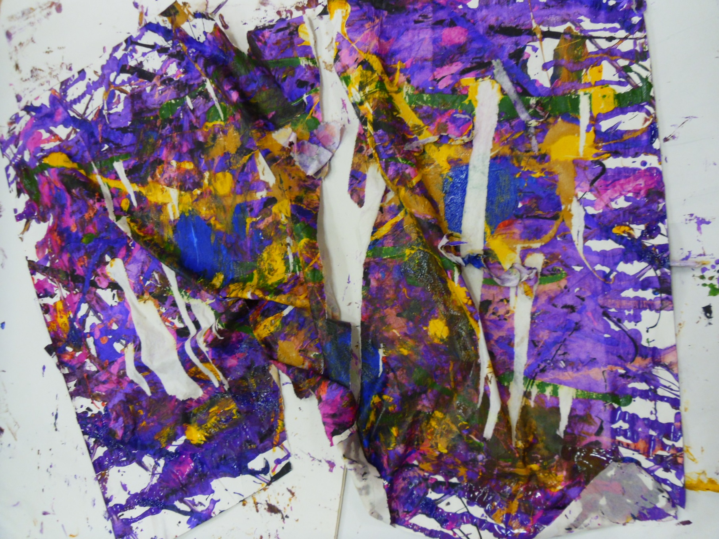
Notes:
So I started again at Level 2 – self diff
We initially created a ‘Destructive Behaviour’ care plan to contain, maintain boundaries and consistency. We then applied the treatment principles. We were more considerate in the activities we engaged him in and he improved. (Cherry pie, marbling, painting, simple model aeroplanes, cleaning art room - vacuuming)
It seemed to contain him, made our approach more consistent and focused our treatment.
The handling was vital in making him feel safe and to trust us and allowed him to express himself freely through creative acts – he said ‘I can use my destructive nature to create’ and he thanked me for allowing him to discover this.
Here are some pieces he has created and not destroyed during the process

Slide 12
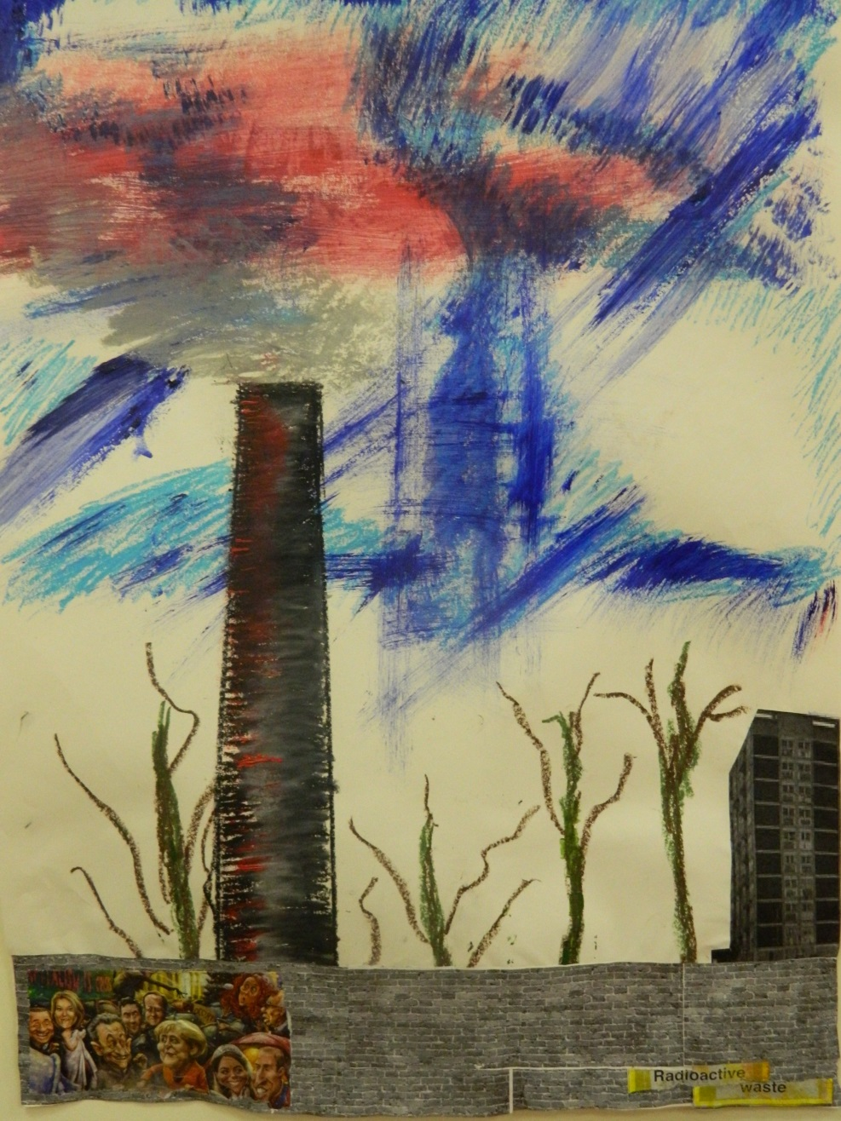
Notes:
What I was doing at the beginning of the initial assessment phase was separating components because of the disparate presentation
Performing tasks– good tool handling, at the time I thought he had task concept because the end product was good and he needed little supervision to do the task
BUT –he had difficulty relating to people, norm awareness was poor, emotional responses, behaviour, initiative & effort not sustained
In my mind I created a divide – I thought, he can do these activities we just need to help him manage his emotions, improve norm awareness, relating to people.
However when I allowed him to choose an activity, because I thought he could do it, he struggled with the more complex cognitive functions – problem solving, judgement, organisation and planning.

Slide 13
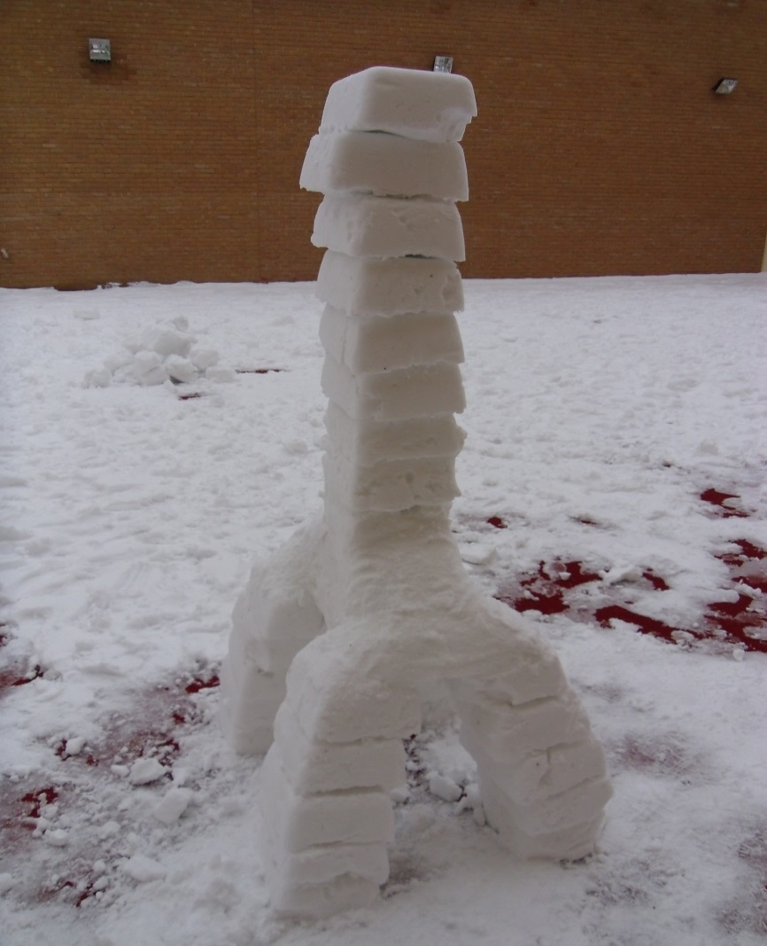
And then it snowed…………
Notes:
Dolls house, recovery tree, model village, coffee stick design, snow! – the demands were too high
Task concept – he would choose a task but then just start it
He was unable to plan, problem solve, judge, be flexible, adapt to problems as they arose
And when it didn’t work, he could see that it wasn’t working, this required some evaluation, which resulted in poor task satisfaction, thus making him look a failure so he would desperately try and rectify what he had made .
His emotional response would then affect his ability to maintain effort and initiative, his behaviour became chaotic.
This impacted on his ability to relate to people at times becoming irritated by their presence.
A combination of all these factors and demands placed upon him being too high resulted in the destruction of the object.
And the snow – the social demands were too high!!

Slide 14
In May 2013 he said……….
I’ve come a long way, and you’ve helped me. And you know what started it ………………. The goose!
Notes:
Without applying the model, I am sure I would still be struggling with this man
Wendy helped me bring the components back together, take a step back and look at the whole picture.
I have also been able to take a fresh look at other patients with this diagnosis and realise I was making similar mistakes with allowing them to choose activities they couldn’t achieve.
Their inability to plan ahead, learn from experience, poor problem solving skills would create extreme reactions due to their poor emotional control, impulsivity, low self esteem and mistrust of people.
And although these patients can appear to function better as certain times and not others, they do not present with a consistent picture but by correctly applying the principles of the model this has given consistency to a confusing presentation.

Slide 15

Reflections……………..
Notes:
I would now like to take this opportunity to invite Wendy and Dain to assist us in further discussions.

