Slide 1
Seclusion:
The end of the road for occupational therapy or a new route with the Vona du Toit Model of Creative Ability?
Louise Jeffries
Senior Occupational Therapist
St Andrews Healthcare, Northampton
6th ICAN International Vona du Toit Model of Creative Ability Conference

Slide 2
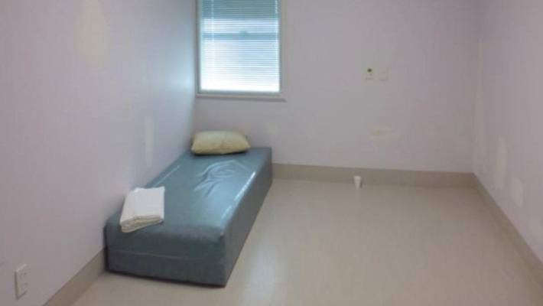
“Supervised containment and isolation of a patient, in a room, from which they are prevented from leaving”.
Mental Health Act Code of Practice (1983)
Notes:
Seclusion is the supervised containment and isolation of a patient, in a room, from which they are prevented from leaving.
Seclusion is used as a last resort when all other de-escalation techniques have been tried and the patient is still presenting a significant risk to themselves or others.
For those of you not familiar with seclusion – this is a typical room – there is usually just a mattress and patients have to eat with paper plates, bowls and cardboard spoons.
Seclusion rooms have an en suite bathroom, however, patients do not have access to toiletries - shower gel and toothpaste are provided in polystyrene cups.
Depending on the risks presented by the patient will depend on what they can have access to.
When the door is opened it requires a minimum of 3 staff – again depending on the risk.

Slide 3
Presentation plan
External drivers
Evidence-based practice
Relate findings to creative ability
Practice-based evidence
Case examples
Questions
Notes:
I will first look at the external forces driving the reduction of the use of restrictive interventions.
I will share the current evidence based practice and relate the findings to creative ability.
I will then explain how myself and my TI changed our practice with patients in seclusion.
I will give two case examples of how we engaged patients on the self-presentation and self-differentiation levels.
The presentation will conclude with some of my own questions and there should be time for you to ask questions at the end.

Slide 4
Department of Health (2014) ‘Guidance: Positive and Proactive Care: Reducing the need for physical interventions’
Mental Health Act (1983) ‘Code of practice’
NICE guidance (2015) ‘Violence and aggression: short-term management in mental health, health and community settings’
NHS England (2016) ‘Reducing Restrictive Practices within Adult Low and Medium Secure Services’
Royal College of Occupational Therapists (2015) ‘Occupational therapists’ use of occupation-based practise in secure hospitals’
Notes:
Twenty years ago the use of seclusion was questioned but benefits accepted.
However, in the last decade there has been a gradual shift in the attitudes towards seclusion and more currently a national drive to prevent or reduce time in seclusion.
The MHA code of practise, NICE and DofH are now all united in implementing least restrictive interventions.
And NHS England are the driving force to implement this in to practise, by setting standards for services to implement strategies to reduce the use of seclusion.
In an editorial piece by Diane Cotterill in the BJOT she makes reference to the New ways of working implementation guide and provides her opinion that OT’s will be expected to become more involved in such interventions. However there has been no response from the RCOT regarding least restrictive practise and of specific interest no reference to it in the guide for OTS working in secure services.
With potential changes in demands of OT’s and increasing pressure from these organisations to reduce restrictive practices occupational therapists must take note.
And so in my search for answers I scoured the literature to find the evidence of OT intervention for this population.

Slide 5

Evidence-based practice
OT’s central to the development of strategies (Tully et al, 2016)
Patients in seclusion were engaged in meaningful & therapeutic activity (Qurashi et al, 2010)
Reduction in number of seclusions (Lee et al, 2010)
No significant difference between engagement and non-engagement with OT compared to time in seclusion (Carlson & Holm, 1993)
Notes:
And I found nothing, a baron landscape containing only 4 articles and focusing on seclusion prevention rather than interventions for patients in seclusion.
So, whilst Tully acknowledged OT’s central to the development of strategies to prevent seclusion, there was no mention of the OT’s role for patients in seclusion. (7)
Qurashi’s study analysing data over a five year period identified a reduction in seclusions and whilst there was mention of the patients being engaged in therapeutic activity, the article did not specify.
Lee saw a reduction in seclusion rates however this was due to sensory interventions in an attempt to reduce seclusions. (43)
And finally Carlson and Holm discovered no significant difference between engagement and non-engagement with OT compared with time spent in seclusion, however again this was seen as a preventative measure. (201)
One could argue the reason for this paucity of research is the drive to reduce such practices and patients in seclusion would often not be able to give informed consent. However, we cannot neglect the fact that sometimes seclusion is a necessary intervention.
So the findings at this point were disappointing but I wanted to pursue this further

Slide 6
Activity participation
Person
Loss of self-identity
Lack of choice and control
Poor emotional control/distress
Occupation
Social isolation
Lack of engagement in meaningful occupation
Lack of structure and routine
Environment
Sensory deprivation
Unable to tend to self care needs (lack of materials/objects)
Notes:
I then began to look at qualitative research gaining the views of patients who had been in seclusion.
And this is a summary of the findings –
Patients reported feeling a loss of self-identity, they had a lack of choice and control.
They suffered with emotional distress and had poor emotional control
They reported feelings of social isolation, lack of engagement in meaningful occupations and lack of structure and routine
There were high reports of sensory deprivation and limited opportunity to engage in self care tasks with such high restrictions on materials and objects.
So the occupational deprivation, alienation and imbalance severely impacted on activity participation and presents a challenging occupational injustice.
I must stress here that many of my patients would struggle to provide such insights in to their experiences due to the acute nature of their presentations, however, it is still highly relevant.

Slide 7
How does this relate to the levels of Creative Ability?
Self – differentiation (Constructive, constructive explorative action) | Self-presentation (Explorative)
Developing self concept – what they like/don’t like - need to relate to and connect with Lack control over themselves Extreme emotional responses Orientation to time, place, person Treatment is focused on sensory and motor | Trying to create self-identity Want to explore different choices Want to have more control over their lives Want to relate to and connect with Want to engage and need structure and routine Poor emotional management
Notes:
So let’s now relate this to creative ability and the needs of our patients on the self-differentiation and self-presentation levels as these are the most common patients requiring seclusion.
I want you to think about the need for OT intervention when thinking about the needs and motivating factors for these patients.
The pts on the SD level are differentiating between their inner selves, outer-selves and the world and beginning to develop self concept – therefore, they need to relate to & connect with their environment.
They lack control, can exhibit extreme emotions – so they need to be orientated to feel safe. The treatment focus is on sensory and motor processing - how can this be done in a sensory deprived environment – this may explain the type of sensory seeking behaviour we see – such as head banging?
For patients on the SP level – they are trying to create a sense of self, want to explore choices and have some control – how must they feel in seclusion – what exploring can they do – this may explain some of the destructive behaviours we see – exploring their ability to remove the toilet door. So they want to relate to and connect with their world, they want to engage and need structure and routine. In seclusion there is little opportunity for any of these and we are then surprised they cannot manage their emotional responses and have to remain in seclusion for longer.

Slide 8

Practice based evidence
Notes:
So now I want to explain the practice based evidence which shows a more flourishing landscape

Slide 9
So what did we do?
Spent time on observations
Continued our usual sessions
Maintained structure and routine
Facilitated self care activities
Kept personal belongings near (laundry, clothing)
Facilitate meals and drinks (eat lunch)
Continued assessment and treatment
Notes:
So considering the needs of patients in seclusion and their levels of creative ability we introduced the following and used the treatment principles to tell us how -
We spent time on patients observations – this allowed for continued engagement and to reduce social isolation, to facilitate orientation and to become familiar faces for new admissions.
We would continue our usual timetabled sessions – so I wouldn’t think I had some free time as I used to do, and so we maintained structure and routine.
We keep personal belongings such as laundry and clothing near to them – we stand at the door and hold them up so they can choose what to wear (even down to their choice of underpants). We sort their laundry with them at the door and either indicate or choose the washing powder.
For self-diff patients we facilitate food and drink, clearly describing what they have. And for self-pres patients we eat lunch at the door with them and explore the food we each have.
This increased input allowed for assessment of new admissions and we could continue treatment for patients familiar to us.

Slide 10
Example timetable (Self presentation)
Monday | Tuesday | Wednesday | Thursday | Friday
Categorising activity | Cognitive game | Do laundry | Room tidy | Cognitive game
 |  | Lunch with Louise |  | Lunch with Riahna
Change library book
Notes:
This is an example programme for a patient on the self-presentation level in seclusion, and his programme didn’t change, in fact it increased to include two lunches.
This patient had poor self-concept, low self esteem and low confidence. He was also impulsive and had difficulty managing this. And so we continued to focus on these treatment needs, by being very creative in the activities we could use. For this individual we could not open the door.
On Monday we would do a categorising game – go to next slide
We would play a range of cognitive games – connect 4, downfall, the alphabet game, ten things you would find in a garage – to help him manage his impulsivity, improve processing, increase self-confidence and self-esteem.
We would have lunch with him twice a week for social contact and social norm awareness.
We would stand and sort his laundry with him and on a Thursday morning we would make sure he collected any rubbish in his room and give him a cloth to wipe his mattress and any spills. This was to maintain the ward routine – the room would always be cleaned and rubbish removed (it wasn’t left for a week)
So this was to demonstrate how we continued engagement for a patient in seclusion, I now want to share with you how we successfully worked with the MDT and got a very disturbed, psychotic gentleman out of seclusion and back on to the main ward area using the model of creative ability.

Slide 11


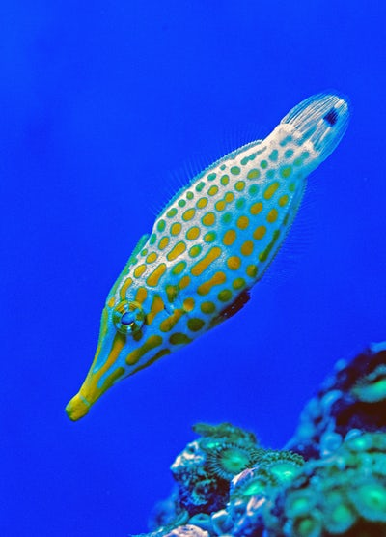
Molluscs | Crustaceans | Fish
Notes:
To develop self-confidence through developing processing skills and understanding of concepts.
This is just one example of categorisation we did.
This task was to categorise sea creatures in to molluscs, crustaceans and fish.
I made a large board and split it in to three sections. I had different pictures of creatures which we would explore and categorise one buy one and stick them in the appropriate section. (this only shows one picture due to limited access)
Myself and the observing nurse would stand at the door and we would do this through the window. The observing nurse would join in the discussion as if we were all working together to reduce the demands on the patient to get the answer right, with the emphasis on exploration. I would apply the treatment principles to ask searching questions to explore the properties of the things we were categorizing.
So, we would have rich discussions about their appearance, the patient would clearly describe each one and we would discuss the similarities and differences.
I would usually throw in something difficult - Is a star fish a fish? – I’ll leave that with you.
He would be engrossed for up to 45 minutes, he would be interacting exploring and most importantly laughing and having fun.
GO BACK TO PREVIOUS SLIDE

Slide 12
Mr A in seclusion
Self-differentiation (Unconstructive)
Monday | Tuesday | Wednesday | Thursday | Friday
Breakfast | Breakfast | Breakfast | Breakfast | Breakfast
Self care | Self care | Self care | Self care | Self care
Tea break | Tea break | Tea break | Tea break | Tea break
Lunch | Lunch | Lunch | Lunch | Lunch
1:1 interaction | 1:1 interaction | 1:1 interaction | 1:1 interaction | 1:1 interaction
Tea break | Tea break | Tea break | Tea break | Tea break
Notes:
So Mr A was admitted in to seclusion as he had been presenting as extremely disturbed in his previous placement.
Myself and my TI immediately began to spend time on his observations to enable assessment.
This looks like a very busy programme but each session only took a few minutes to increase his focusing of attention and to improve his ability to relate to materials, objects and people.
Sometimes we couldn’t make it but we would try.
Throughout each interaction we would orientate Mr A, calling his name, telling him the time, ‘it will be lunch time soon’, to look out the window and see the sunshine or rain.
We would develop self concept – used a mirror so he could see himself, do simple stretching exercises, he would sing and dance and we would comment on this.
We would develop concepts - give him his lunch and describe it to him. We would also provide him with basic toiletries so he could shower.
And it was Christmas time so we would bring him festive things to look at and eat.
As he was improving, in more lucid moments he could play one game of noughts and crosses.
Initially he presented as extremely psychotic, banging, shouting, punching self in face.
But then he began ripping paper cups, plates, tearing toilet paper and soaking it in urine. The medical team thought he was doing this in protest and deliberately. I argued this and instead suggested he was improving as he was being incidentally constructive rather than unconstructive, to which they agreed.

Slide 13
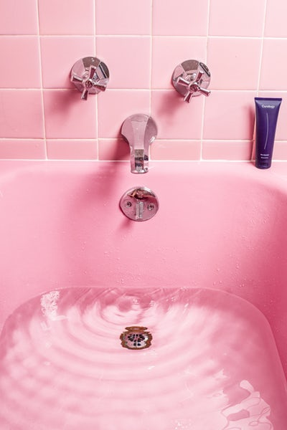


Mr A - exiting seclusion
Self-differentiation (Incidentally constructive)
Bath
Vape in courtyard
Football in courtyard
Notes:
When it was felt he no longer needed to be in seclusion he was immediately allowed on to the main ward. Which on two occasions ended in seclusion within 15 minutes. So the team suggested he could spend time out of seclusion to gradually introduce him to the ward, e.g. getting medication, spending time in his bedroom.
I suggested these were unmotivating and unstructured situations. The model informed me that Mr A needs an activity which facilitates immediate engagement, with instant gratification, which lasts 5-10 minutes. He would also need a motivating factor to return to seclusion.
So using the treatment principles we devised a plan which consisted of short sessions doing something more concrete (going for vapes, bath, football).
So to give an example - I would run his bath then go and fetch him with two escorts. We would put bubble bath in and make the bubbles together. I would orientate him to his shower gel and soft flannel. He would have a clean set of clothes. I would then stand outside of the bathroom and shout instructions – wash under your arms Mr A – he would occasionally shout wanting to know I was still there.
Once finished he went back to seclusion for a nice cup of coffee and some biscuits.

Slide 14

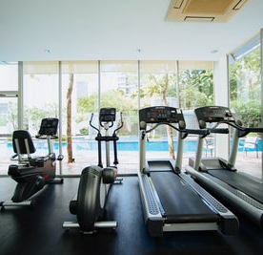
Long term segregation
Self-differentiation (Incidentally constructive)
Bath once a day
Vape time
Lunch/dinner
Tea breaks
Treadmill
Notes:
The graded programme gradually increased access out of seclusion and so the team wanted to trial him being nursed in the main bedroom corridor of the lounge. I expressed my concern with this as I could predict the outcome – because the model told me it would be too stimulating.
When I came in to work the next day he was in seclusion again.
And so the team listened and we decided to nurse him in our extra care area – a quiet area off the main ward with two rooms and a bathroom with three nurses present.
We continued the very gradual exposure to the ward continuing with regular baths, we introduced a 10 minute exercise session, we would take him in for meals in the dining room without other patients – and so we continued to grade this – increasing the amount of time and the number of people with whom he came in to contact.
The OT team devised a very detailed care plan on how the observing nurses should engage and relate to Mr A on a daily basis due to his sensitivity to stimulation.
So with persistence and consistency with applying the treatment principles Mr A is now on the ward all day and just returns to the LTS to sleep.
Without the model of creative ability, I have no doubt that this gentleman would have spent extensive periods of time in seclusion. At worst he now only requires an hour or two. This learning process has made the MDT more aware of the reasons behind behaviours, increased their understanding of the treatment principles and they are more proactive in bringing him out as they have a clear care plan of how to positively engage him and manage his challenging behaviours.

Slide 15
Activity Participation Outcome Measure
8 domains
53 items scored
Notes:
This is Mr A’s Activity Participation Outcome Measure
The inner circle captures Mr A’s presentation whilst highly disturbed in seclusion – on the Self-differentiation (therapist directed phase) and the outer circle demonstrates the level when he exited seclusion on the patient directed phase.
Whilst there is an overall improvement in all domains there is a marked increase in the score for balanced lifestyle, demonstrating the occupational deprivation whilst in seclusion.

Slide 16

Through my observations and engagement of patients in seclusion………. I further question………
Can the VdTMoCA reduce the use of seclusion?
Can the VdTMoCA inform risk profiles?
Can the VdTMoCA provide a safe level of creative ability to exit seclusion?
Can the VdTMoCA inform risk assessment and management?
What is the EFFECTIVENESS?
Notes:
At the beginning of the presentation I asked if the model of CA could create a new route to access patients in seclusion and I hope I have demonstrated that it can.
However it was through applying the theory to practice which created more unanswered questions.
Can the model help reduce the use of seclusion?
Can the model inform risk profiles? To assist in predicting and reducing risk
Can the model provide a safe level of creative ability to exit seclusion? – for individuals
Can the model inform risk assessment and management? – I know the answer is yes - there are clear differences in the types of risk behaviors displayed on the different levels of CA and clear differences in the reasons behind these – this is powerful and rich information.
So, I know the answer is yes to all of these questions but how effective can it be? and to find out we have to produce some evidence based practice.

Slide 17

‘The important thing is not to stop questioning. Questioning has it’s own reason for existing’.
Albert Einstein
Any questions?
Notes:
Thank you for listening – do you have any questions?

Slide 18
References
Carlson, J and Holm, B. (1993) Effectiveness of occupational therapy for reducing restraint use in a psychiatric setting. The American Journal of Occupational Therapy. 47 (10), pp 885 – 889.
Department of Health (2014) Positive and Proactive Care: Reducing the need for Restrictive Interventions. [Online] Available from URL: https://www.gov.uk/government/publications/positive-and-proactive-care-reducing-restrictive-interventions. [Accessed on 15/05/2019].
Lee, S, Cox, A, Whitecross, F, Williams, P and Hollander, Y. (2010) Journal of Psychiatric Intensive Care. 10 (6) pp 83 – 90.
Mental Health Act Code of Practise (1983) [Online] Available from URL: https://www.gov.uk/government/publications/code-of-practice-mental-health-act-1983. [Accessed 15/05/2019]
NHS England (2016) Reducing Restrictive Practice within Adult low and medium Secure Service Guidelines: NG10: Violence and Aggression: Short Term Management in Mental Health, health and Community Settings. [Online] Available from URL: https://www.England.nhs.uk/publication/prescribed-services-cquin-scheme-mh3-reducing-restrictives-practices-within-adult-low-and-medium-secure-services/. [Accessed on 14/05/2019].
NICE Guidelines: NG10:Violence and Aggression: Short Term Management in Mental Health, Health and Community Settings. (2015) [online] Available from URL: https://nice.org.uk/guidance/ng10/chapter1/ recommendations. [Accessed 15/05/3029]
Qurashi.I, Johnson.D, Shaw.J, Johnson.B. (2010) Reduction in the use of seclusion in a high secure hospital: A retrospective analysis. Journal of Psychiatric Intensive Care. 6 (2), pp 109 – 115.
Royal College of Occupational Therapists (2017). Occupational Therapists use of Occupational Focused Practise in Secure Hospitals. [Online] Available from URL: https://www.rcot.co.uk/practice-resources/rcot-practice-guidelines/secure-hospitals. [Accessed on 14/05/2019].
Tully, J, McSweeney, L, Harfield, K.L, Castle, C and Das, M. (2016) CNS Spectrums. (21) pp 424 - 429

