Slide 1
The OT Coffee Shop
Vocational Rehabilitation Project in OT Psychiatry at CHBAH
Lynn Soulsby
Senior Occupational Therapist
Coordinator
OT Psychiatry
CHBAH

Slide 2
Background
Difficult for MHCU’s to enter open labour market
Need for vocational rehabilitation program
Structured program- prevocational and vocational skills assessed and treated in supervised environment
September 2008- OT Dept started a coffee shop
Notes:
Through experience, it was found that patients with a mental illness find it difficult to enter the open labour market. This is further complicated by reduced work experience/ an erratic work history. The need for a vocational rehabilitation program was identified, and a structured program was developed. This allowed for the assessment and treatment of prevocational and vocational skills in a supervised environment. The OT coffee shop was started in September 2008.

Slide 3
Purpose
Improve ability to work in the open labour market (provide opportunity for work experience)
Focus on prevocational and vocational skills (including social skills)
Promote general mental health- adherence to treatment, constructive use of time, decrease substance abuse, improve function and independence

Slide 4
How does it work?
Graded, therapeutic program
Treatment, not employment
Patients receive tips from customers
Money- groceries, equipment, transport
Tasks/responsibilities fit specific skills/ needs of clients
Training sessions- prevocational and vocational skills (professional chef/ visit to coffee shop)
Developmental approach
Notes:
The coffee shop is a graded therapeutic program. The focus of the program is therapy, and it is not a form of employment. MHCU’s do not receive a salary, but do receive tips from customers. These tips are divided equally among patients who are in the coffee shop on that day. The money made from the coffee shop is used to buy groceries, new equipment and to fund transport for the patients. If a patient does not attend for more than consecutive 3 weeks, without informing us, they will be eliminated from the programme and a new MHCU starts. At the end of the programme they receive a certificate and report stating their attendance and achievements in the programme. New patients will sign a contract stating that they agree to and understand these terms.
The tasks/ responsibilities that the MHCU is given need to fit the specific skills/ needs that he/ she may have. The MHCU’s are trained prior to each stage/ phase. The training is done by the therapists and a professional volunteer chef. The MHCU’s are also taken to a coffee shop, to experience being a customer and analyse the waiter according to a checklist of waiter skills and attributes. The programme takes a developmental approach, looking at providing an opportunity for prevocational and vocational skills to be both acquired and consolidated.

Slide 5
Guidelines for a suitable candidate include:
Motivation to participate in program
Positive attitude to the program
Ability to follow instructions and execute basic tasks with minimal assistance
Adequate personal hygiene – ability to perform daily hygiene tasks appropriately
Ability to make some contact with others
Appropriate basic communication skills
Safety of self and others
Notes:
A screening tool has been developed to identify suitable candidates for the program. MHCU’s need to have the following before entering the coffee shop:

Slide 6
Model of Intervention
Stage 1: Motivating
Phase 1
Phase 2
Level 1
Level 2
Outcome – protective/sheltered
Stage 2: Developing
Phase 3
Outcome – unskilled/supervised
Stage 3: Consolidating
Phase 4
Phase 5
Outcome – open labour/self employed
Notes:
The Model of Intervention consists of 3 stages: Motivating, Developing and Consolidating. Within the stages are various phases. Each stage focuses on the acquisition and consolidation of different aspects of prevocational and vocational skills. The outcomes of each stage are different- protective/ sheltered; unskilled/ supervised; open labour/ self employed. This was designed to include those with lower levels of participation and action as well as those who have the potential to consolidate higher level skills, such as the ability to manage and supervise others/ work with money/ control stock, and so forth. Each patient is given a minimum of 6 months in the program. During this time they move through the stages and phases as they develop the necessary skills. They are reassessed at the end of 6 months to ascertain whether or not they have plateaud and can be referred on appropriately, or whether there is still room for improvement. If they stay on for another 6 months, they continue to progress through the stages, acquiring and consolidating skills as they go.
Once a MHCU has been screened and accepted into the program, they are assessed to determine their skills. This enables them to be placed on the correct level by considering hygiene, social interaction and skills. It is therefore not essential that a new patient enters the program on phase 1, or leaves on phase 5.
The therapist will fill in on the stages/ phases where there are no patients (usually stage 3).

Slide 7
Stage 1: Motivating
Phase Level Activity Task
Phase 1
Cleaning Washing dishes
General cleanliness
Clearing tables
Phase 2
Level 1
Meal prep Prepare beverages
Level 2
Meal prep Cooking, Baking
Plating food
Outcome – protective/sheltered
Notes:
Stage 1 is the Entry Level Stage. The responsibilities in phase 1 focus mainly on basic survival skills and home maintenance activities. The MHCU’s working in this stage will be responsible for cleaning, clearing and washing dishes. In phase 2, the responsibilities include meal preparation. Within Phase 2 the responsibilities differ slightly and allow for more grading. In Level 1 the MHCU is responsible for preparing beverages, and in Level 2 for preparing and plating the meals.
Based on the skills in this stage we expect that if these are consolidated and the most a MHCU will achieve they will be suitable for protective or sheltered employment.

Slide 8
Stage 1: Phase 1
Motivation to work (or attend program)
Ability to follow verbal instructions
Ability to learn new information
Acceptable rate of work
Adequate personal hygiene
Ability to make good contact
Intact basic social skills
Stage 1: Phase 2:
All of the above must be met and the following:
  Social Skills developing further
  Good personal hygiene and consolidated RFOC
  Consolidated task concept
  Consolidated work competency skills
  Consolidated personal presentation
  Precaution: It is important not to be impulsive at this stage
Notes:
Based on the Model of Creative Ability the skills required for an individual to enter at this point include:
Stage 1: Phase 1
Motivation to work (may not have motivation to find work independently but with structure is motivated to attend programme)
Ability to follow verbal instructions
Ability to learn new information
Acceptable rate of work
Adequate personal hygiene
Ability to make good contact
Intact basic social skills – awareness of presence of others, verbal communication
Stage 1: Phase 2:
All of the above must be met and the following:
Social Skills developing further - including awareness of needs and feelings of others but response is not expected to always be appropriate on Level 1
Good personal hygiene and consolidated refined forms of self care
Consolidated task concept
Work competency skills consolidated
Personal presentation consolidated
Precaution: It is important not to be impulsive at this stage

Slide 9
Stage 2: Developing
Phase Activity Task
Phase 3
Serving Taking orders on phone or at table
Serving customers
Outcome: unskilled or supervised labour
Notes:
In phase 3 the MHCU will be responsible for taking orders and serving the customers. Based on the skills consolidated in this stage an individual may be expected to work in an unskilled occupation or a highly supervised position in the open labour market.

Slide 10
Stage 2: Phase 3
All of the stage 1 requirements must be met and the following:
  Social Presentation – communication, awareness of and appropriate response to social cues and norms
  Emotive – control expression and anxiety, stress management developing
  Intact self esteem
  Conflict resolution and assertiveness developing
Notes:
Skills required to enter in to this stage:

Slide 11
Stage 3: Consolidating
Phase Activity Task
Phase 4
Money Mx Receive money
Keep a record of daily takings
Cash up
Phase 5
Business Mx Book keeping
Stock control
Overseeing staff
Outcome – open labour/self employed
Notes:
Phase 4 and 5 require higher order skills. Phase 4 involves money management or being a cashier where the MHCU will receive money, give change, work the till, keep a record of daily takings and then cash up at the end of the day. Phase 5, in the final phase, the individual will be responsible for management of the business involving book keeping, stock control, and generally overseeing staff.

Slide 12
Stage 3: Phase 4
All of stage 1 and 2 requirements must be met and the following:
  Consolidated cognitive skills including executive functions
  Able to tolerate frustrations
Stage 3: Phase 5
In this stage social skills and work competency are the focus
Patients should be ready for the open labour market, they should be gaining work experience and practicing skills and preparing for productivity - employment or starting their own business.
Notes:
Skills required to enter into this stage are:

Slide 13
Practical Implications
Maximum of 3 patients at one time
7:30 - 3:45, Fridays only
OT supervises for whole day , instead of rotation
Stock take in morning and afternoon, grade involvement – responsibility, easily graded tasks, practical
Bake and prepare some food in the morning
OT’s do shopping
Customers- staff

Slide 14
Practical Implications
Goes beyond a Friday program in OT – reports, handover, shopping etc
Menu- easy to prepare/ variety/ specials
Patients – find employment during time in coffee shop
During/ towards end of program – CV writing, job seeking skills, learnership applications, referral to Progression etc.

Slide 15
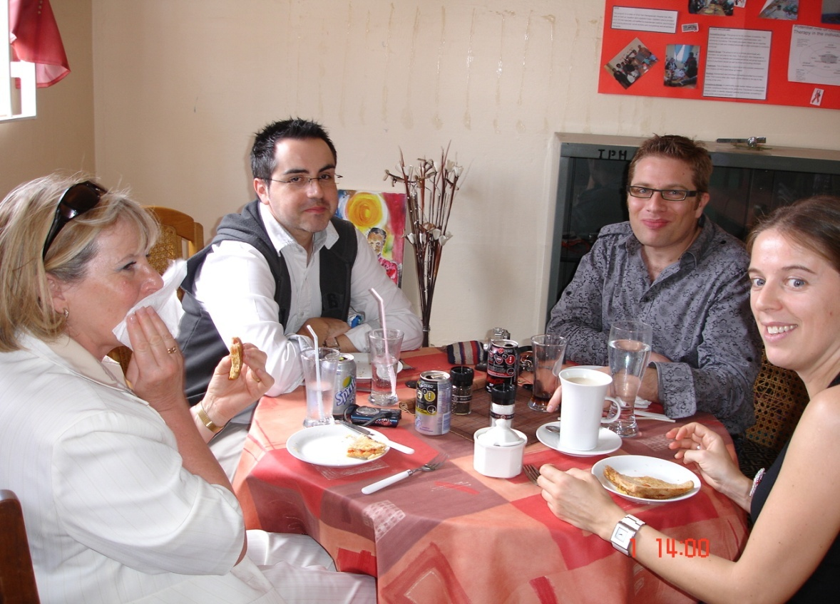
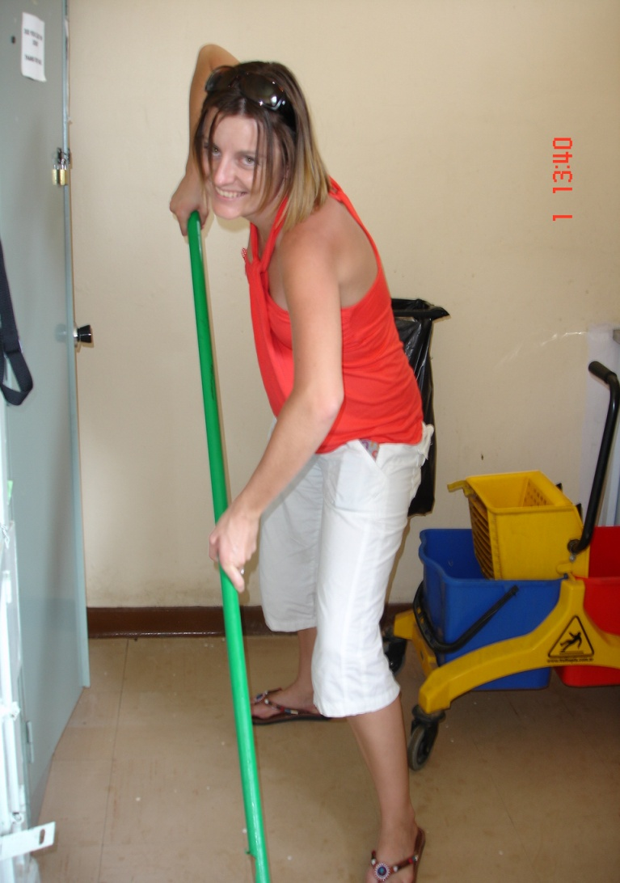

Slide 16
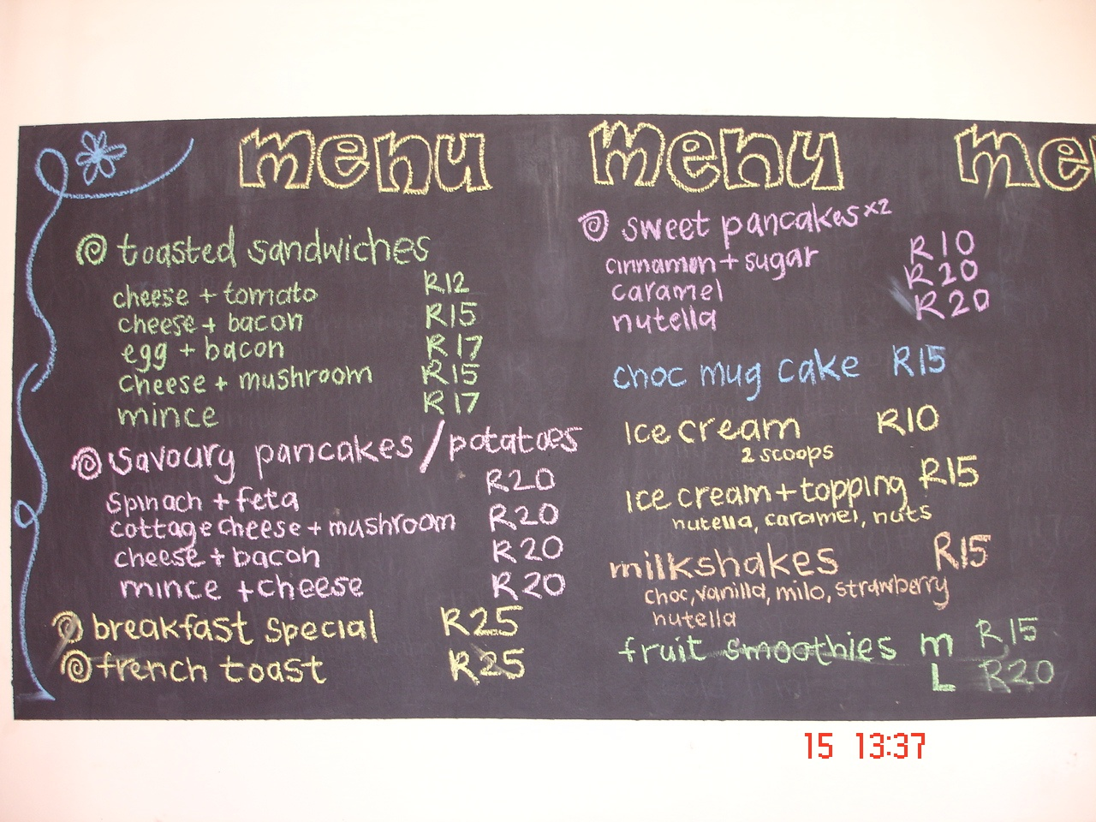
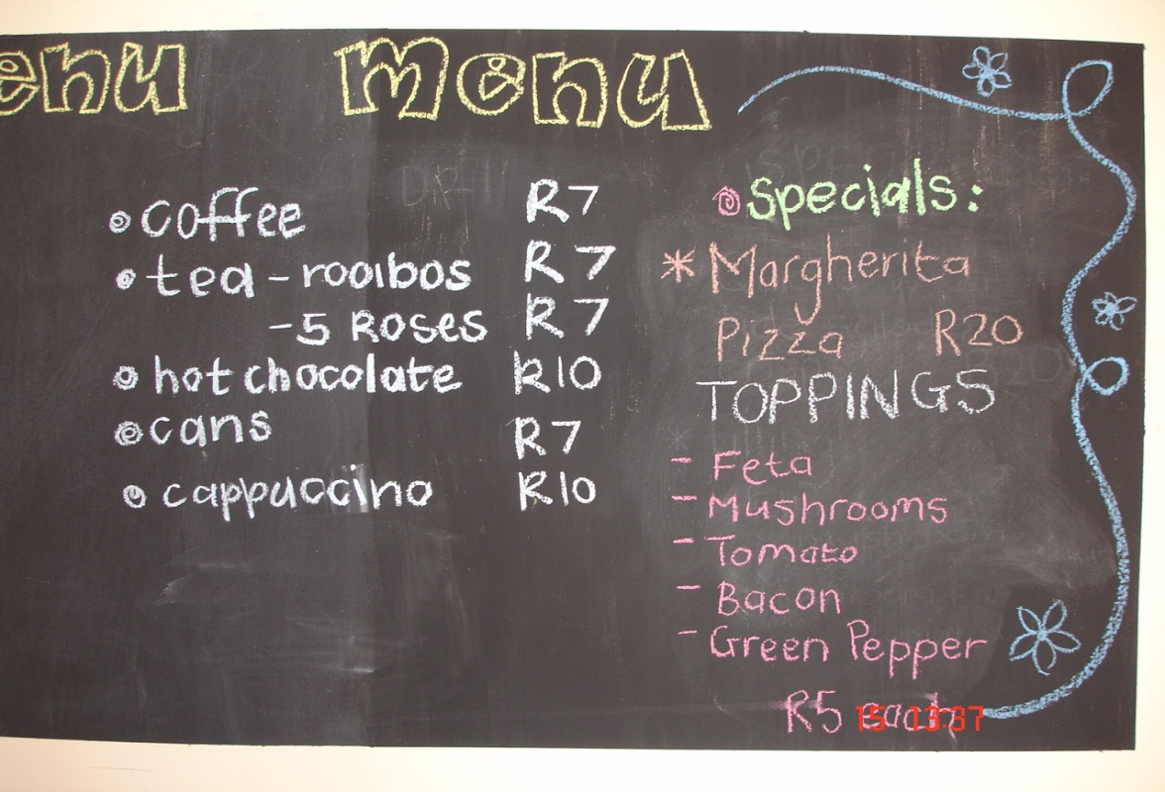

Slide 17
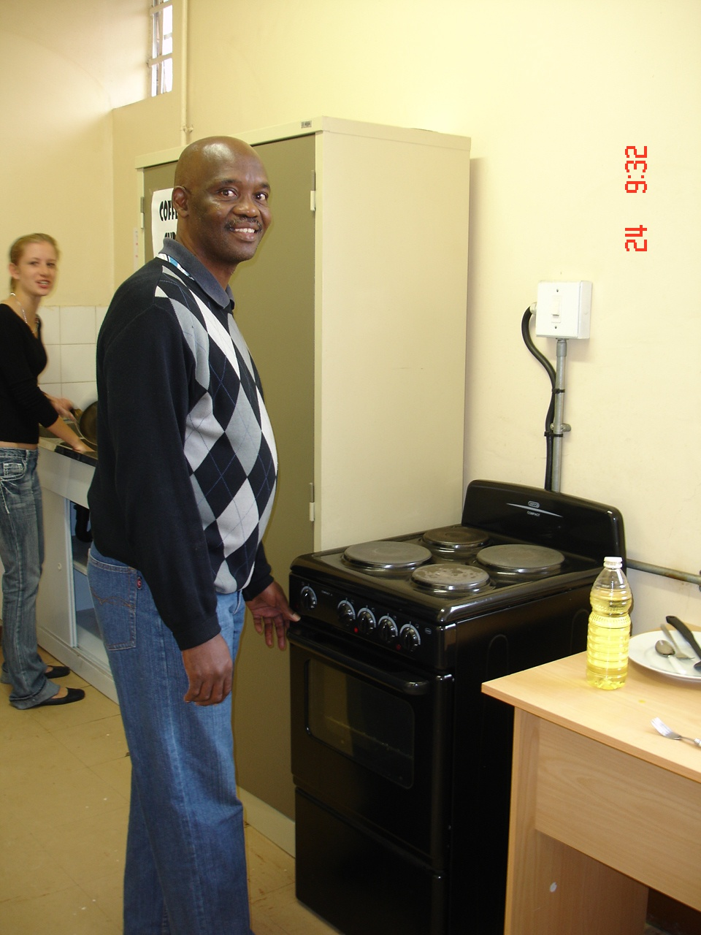
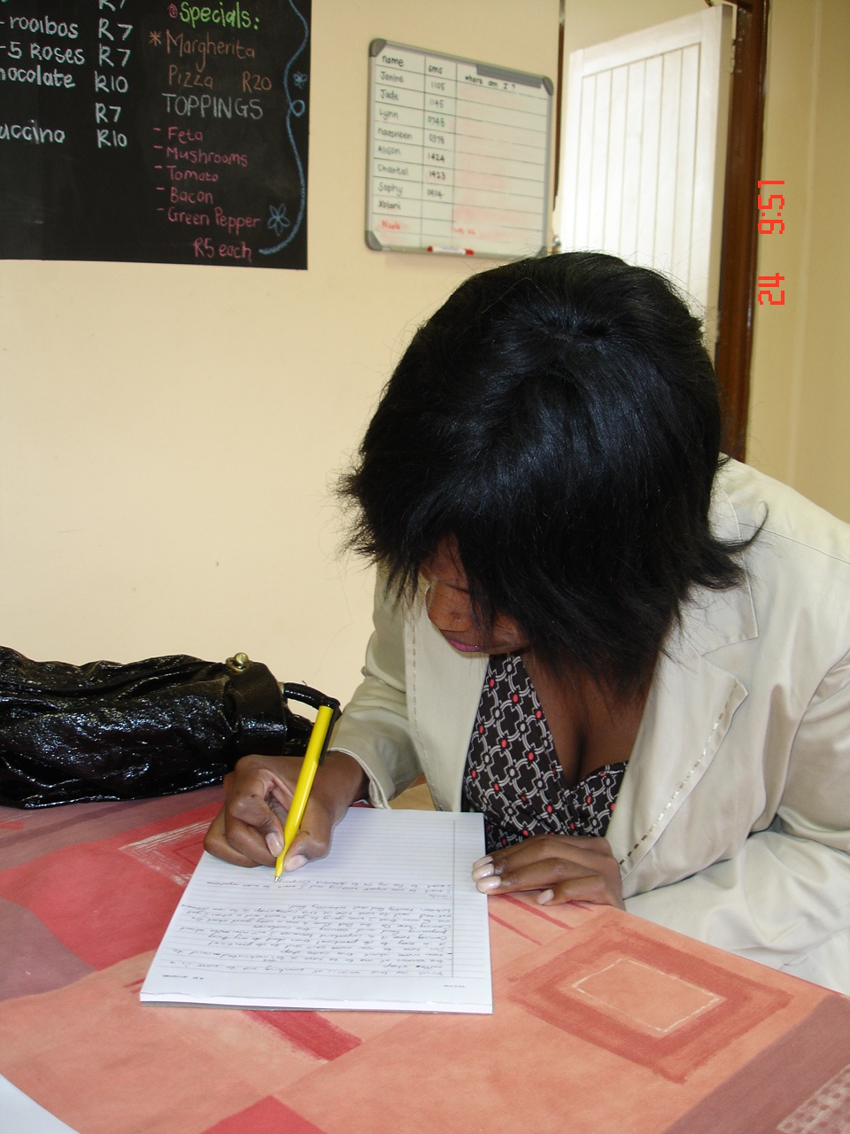

Slide 18

