Slide 1
The South African Model of Creative Participation
Presented by Dain van der Reyden
UKZN
08 March 2012

Slide 2
Developed by Vona du Toit
Developer of Model
Inspirational visionary thinker
Advocate for the profession and service
Key figure in development of Occupational
Therapy in South Africa in the sixties and
seventies
Honoured – nationally and internationally

Slide 3
The Origin of the Model
Passionate belief in activity as therapeutic medium
Phenomenological approach to man
Research done on initiative
Work done by Weinstein and Schossberger (Israel)
Teachings of Buber, Rogers and Piaget
1968 – Presentation – Hong Kong
1974 – Presentation – WFOT Congress – Canada
Development limited to South African context

Slide 4
What, then, is the Model of Creative Participation?
Developmental model
Defines motivation
Indicated interrelatedness between motivation and
action
Teaches what motivates people
Gives a way to measure strength of motivation
(through assessment of action)
Provides strategies to elicit motivation
Identifies criteria for determination of performance of each
level

Slide 5
Comprehensive guidelines for intervention at nine
interdependent and sequential levels of motivation
and action (occupational performance).
This includes:
  Principles for:
    relating to the individual
    structuring of treatment situation
    presentation of activity
  Activity requirements
  General management and grading
  Programme content
Practical, user-friendly model, applicable in most
treatment settings and diagnoses

Slide 6
Fundamental Concepts
CREATIVE CAPACITY = creative potential of each individual (mental health, security, intelligence, personality, environmental opportunity)
CREATIVE RESPSONSE = positive attitudinal response - preparedness
CREATIVE PARTICIPATION = process of being actively involved in everyday living
CREATIVE ACT = Product producing end-point – result of creative response and creative participation
CREATIVE ABILITY =
  Creative instinct / attitude
  Inner drive / motivation – directs behaviour
  Relational contact with materials, objects, people & situations
  Control of the negative effects of anxiety
  Action leading to end product
  Exertion of maximum effort
  Growth towards actualisation

Slide 7
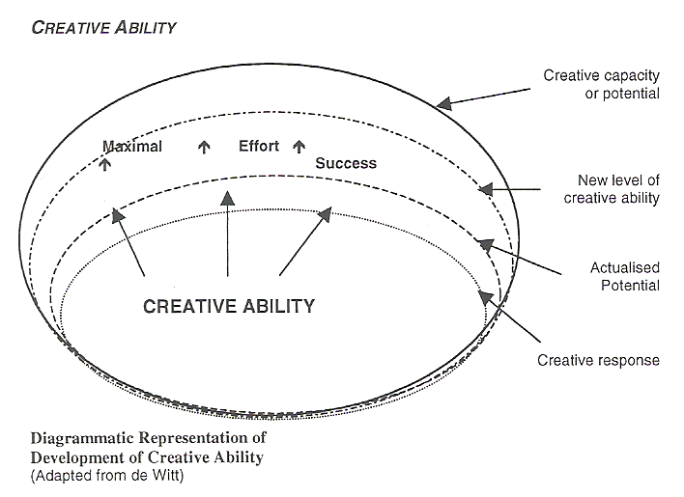
Diagrammatic representation of Development of Creative Ability

Slide 8
Fundamental Concepts
Levels of Motivation:
    Indicates what motivates a person
    Strength of motivation
    Stages of development
Levels of Action:
    Indicates exertion of motivation into physical or mental effort
    Creation of tangible or intangible end product
    Level of skill and occupational behaviours

Slide 9
Fundamental Concepts
Volitional component – initiates / directs behaviour towards goal
Action component – exertion of motivation into mental and physical effort
Tangible or intangible product
Volitional component governs action component
Action expresses volition
Action (results) feeds into volitional component

Slide 10
Relationship between levels of:
Motivation
Tone
Self Differentiation
Self Presentation
Participation
Passive
Imitative
Active
Competitive
Contribution
Competitive contribution
& Action
Pre- destructive
Destructive
Incidentally constructive
Explorative
Experimental
Imitative
Originative
Product Centred
Situation Centred action
Society Centred action

Slide 11
Each of the levels are further described in terms of:
Ability to handle tools, materials and objects in the environment
Quality of relating to people
Handling of situations
Expected behaviour
Task and other concepts
Norm awareness
Initiative and effort
Anxiety control and range of emotional responses
Quality of task execution / product
Level of performance in terms of:
  Personal management tasks
  Productivity / work ability
  Use of leisure time and activities

Slide 12
Contribution to Professional Practice
High focus on activity selection, analysis and application
Detailed method / procedures for intervention at very low levels
of function
Graded programme for activity participation leading on to work
participation
Efficient system of categorisation of individuals – enabling
therapeutic intervention for large numbers
Cost effective treatment systems for large numbers
Enhancement of training and practice for OTAs and CRWs
Proven effective implementation in field of psychiatry, mental
health and paediatrics
Adds additional dimension to intervention for persons with
physical disorders

Slide 13
Development of the Model within the Profession
Pretoria College
Individual treatment
Greater emphasis on activity participation component of theory
Terminology change (Pretorius)
Physical recovery
Self differentiation
Self presentation
Passive participation
Imitative participation
Active participation - upwards
Various training centres
Management of large numbers
Assessment
Clarification
Programmes
Creative participation
Unconstructive level
Constructive
Norm awareness
Norm compliance
Norm transcendence

Slide 14
Reclassification of Stages into 3 Groups
Group 1 :
Preparation or constructive action
Tone
Self differentiation
Group 2 :
Behaviour & skill development for norm compliancy
Self presentation
Passive participation
Imitative
Group 3 :
Behaviour & skill development for self actualisation
Active participation
Competitive
Contribution
Competitive contribution

Slide 15
Application to mainly psychiatric disorders, cerebral palsy
Use of selected graded activity sessions
Hands-on application by Occupational Therapist
Hospital / School setting
Creative Participation as model
Novel way of thinking
Chronic conditions, mental handicap and head injuries
Extensive daily programmes including all aspects of ADL
Application by support staff and CRWs – organisation and management by OT
Hospital / School / Community Centre / Clinics
Correlation of Creative Participation with other models used
Part of everyday therapy (commonplace)
Applied extensively by large proportion of members of the profession

