Slide 1


The Vona Du Toit Model of Creative Ability
An introduction to the model and its use in practice
Alison Kane
Roshni Khatri

Slide 2
History of the VdT Model of Creative Ability
Developed in the 1960’s and early 1970’s in South Africa
Based on the developmental model and the theory of motivation and action
Creative ability our ability to grow and develop in response to the
demands of the world around us.
not in sense of being artistic and producing beautiful end products

Slide 3
Current Level of Creative Ability
Creative
capacity
Maximal
Creative
Effort
New level of
Creative Ability
Based on diagram by de Wit (2005)

Slide 4
Motivation
Inner drive that initiates occupational behaviour
Dynamic, Intrinsic, Extrinsic
Different focus at different stages of occupational development
6 different and sequential levels aimed at developing life tasks
Tone, self-differentiation, self-presentation, participation, contribution, competitive contribution
Notes:
Ask what motivates you to get up each day – if poorly …….

Slide 5
Action
Translating motivation into physical and mental effort to produce occupational behaviour and an end product (tangible or intangible)
10 different levels: sequential differences in quality of ability to form contact with others, events, materials, objects and characteristics of engagement in occupations
Predestructive, destructive, incidental constructive action, explorative, experimental, imitative, original, product-centred, situation-centred, society-centred

Slide 6
Levels of Motivation and Action
 | Motivation | Action
9 | Competitive contribution | Society-centred
8 | Contribution | Situation-centred
7 | Competitive | Product-centred
6 | Active participation | Original
5 | Imitative Participation | Imitative
4 | Passive Participation | Experimental
3 | Self-presentation | Explorative
2 | Self-differentiation | Incidental constructive Destructive
1 | Tone | Pre-destructive

Slide 7
Notes:
The model describes 9 levels of motivation (based upon the developmental model) and links this with action. Through observation, we can see someone's action and therefore determine what is motivating them. In this acute setting, we only see people who are between levels 1 and 5.
Level 1 – tone
Imagine a new born baby and its action. Their motivation is purely to exist and to have their most basic needs met. Someone at this level may have been admitted with end stage dementia, severe learning disabilities or are catatonic. In the hospital they would require 24 hour care from nursing staff to feed them and attend to personal care. They would spend the majority of their time in their bed space and we would take our treatment to them on a 121 basis- trying to establish minimal contact.
Level 2- self differentiation BLUE
Next we move on to level 2. People at this level would have the motivational level similar to a toddler. A toddlers motivation is around distinguishing themselves from others and the environment. In the hospital, people who are floridly psychotic would present with this level of motivation. They would be the patients who knock regularly on the office door and want their needs (cigarette, mobile phone) there and then. In terms of OT treatment, we would not expect patients at this level to attend OT sessions, rather we would take 121 activities, usually of a physical or sensory nature to them. We would attempt to engage them for around 5-10 minutes in a practical basic task.
Level 3- self presentation YELLOW
Describes the motivation of a school age child up until the age of around 8. Motivation is to start to form relationships, understand their likes and dislikes and explore their environment. Most of the patients we have in the adult acute services are at this level of motivation. They are able to concentrate for around 20 minutes if a task has a practical basis and has around 3-4 steps. The tasks must be flop proof so there is no sense of failure and social norms are taught so there is an awareness, but there is no expectation that people at this level will be able to adhere to them. We provide two yellow treatment sessions daily.
Level 4- passive participation GREEN
Imagine you are a young teenager (8-14 what would your motivation be? To fit in. You would be conscious of how you came across, you might be a quiet person in a group, listening and judging what the expected response from yourself might be. People at this level in the hospital are typically granted leave from the ward, they are expected to structure their own time more effectively and independently and access the community more regularly as they will be nearing discharge. Concentration can be maintained for around 45 minutes and task can be around 5-7 steps in complexity. We run two green groups nearly every day.

Slide 8
Creative ability phases:
Wide range of skills and abilities within each level
Need to identify where the client is at in each level
Therapist-directed phase: skills and occupational behaviour characteristic of both previous and current level; may not be able to maintain functioning without support, encouragement, structure and may regress
Patient-directed phase: occupational behaviour can be maintained independently and behaviour is evidently characteristic of a specific level
Transitional phase: some occupational behaviour characteristics of the next level but only under optimal circumstances; overall occupational behaviour is characteristic of current level

Slide 9
Activity
Origami

Slide 10
*Task concept
Task selection
Task execution
Task completion
Task evaluation
Task satisfaction

Slide 11
Concept Formation
Basic
Elementary
Abstract

Slide 12
Performance Components
Physical
Sensory
Cognitive
Perceptual
Psychological
Social

Slide 13
Key Elements
Creative Ability
Motivation
Task Concept
Concept formation
Notes:
CA – persons ability to participate in meaningful activity * define ability
Motivation: internal or external * define
Task concept: describe the task concept for making a cup of tea on 4 levels –physical, cognitive, psychological, social
Concept formation: levels of concept formation

Slide 14
Assessment:
Evaluate client’s current skills and abilities in occupational performance areas: work, social, constructive use of free time, personal management
Types of assessment include: Familiar and unfamiliar tasks and Observation
Establish level of action
Draw a conclusion about level of motivation from level of action

Slide 15
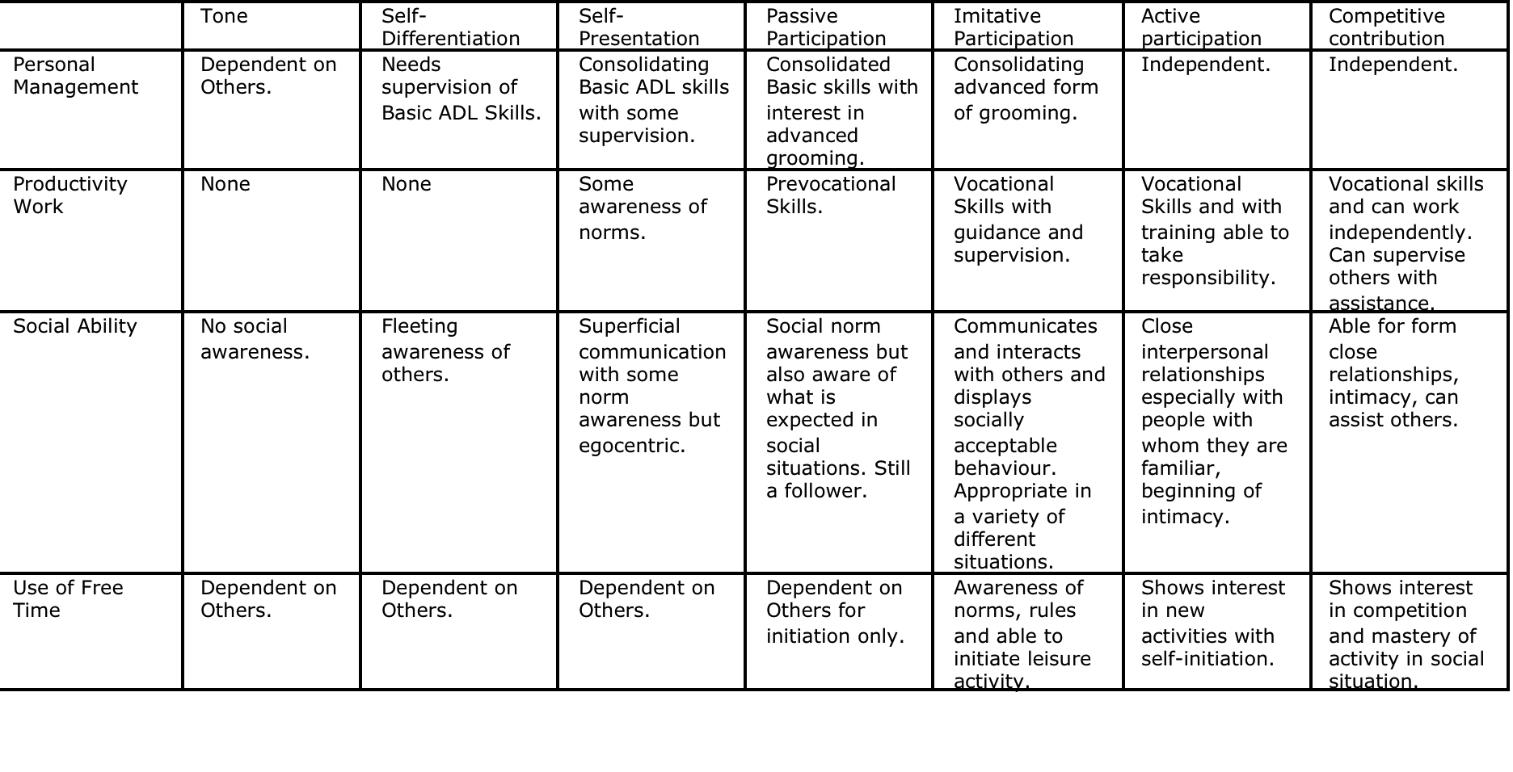

Slide 16
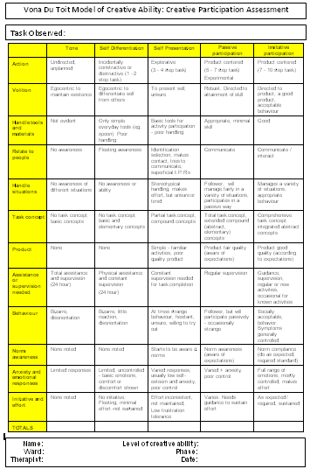
Assessment tool
Action
Motivation
Handling tools
Relating to people
Handle situations
Task concept
Product
Supervision
Behaviour
Norm awareness
Emotional responses
Initiative/effort
Notes:
Once a person has been observed in a task, a creative participation tool is completed. It has the first five levels of the model in columns and we mark each person on twelve different aspects of a task;
Action
Motivation
Handling tools
Relating to people
Handle situations
Task concept
Product
Supervision
Behaviour
Norm awareness
Emotional responses
Initiative and effort
We then tally the scores at the bottom of the sheet and are able to work out someone's level of motivation, their level of creative ability from this.

Slide 17
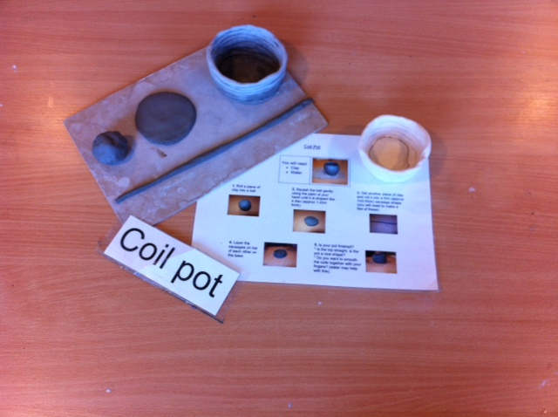
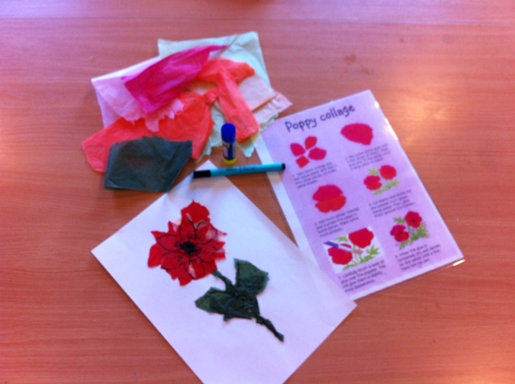
Task assessment
Notes:
A task assessment is a task that lends itself to being adapted to suit a range of the MoCA levels. The task assessments we complete at the berrywood can be completed individually or within groups and are usually 2-5 steps. The assessments are usually art or food based.
You can see from the picture of the coil pot task assessment that pictorial instructions are given. If you break the activity down in to steps you have
Rolling the clay in to a ball
Flattening the ball out
Rolling out clay sausages
Making a slip and
Building the pot up gradually.
For someone at a low level this can be adapted so for example the sausages could already be rolled out. Or you could take away the instructions and use the clay as a sensory object. It could also be adapted for the higher levels. Often when I have used this assessment in the past you will have someone at a green level approaching you the next day and asking if their pot has been fired yet as they want to paint it. Using art based tasks such as pottery allows for this individualism to occur.

Slide 18
Activity
Read the Client Narrative
Place him on the appropriate level in the areas of Personal Management, Productivity, Social Ability and Free time

Slide 19
Level of Motivation: Self Differentiation
Level of Action: Destructive Action
Client has primitive interaction with the world
Handles materials and objects destructively
Not intentional – but lack ability
Do respond to external stimuli
Action is of short duration and non constructive
Interaction is unplanned and non specific
Still dependent and defenceless

Slide 20
Treatment: Self Differentiation - Destructive
Principle of treatment:
Stimulate body awareness esp. boundaries
Stimulate awareness of self and others and objects
Improve attention span
Improve physical ability
Improve psychological ability
Needs consistent approach

Slide 21
Treatment: Self Differentiation - Destructive
Activity Requirements:
Encourage destructive action
Continue to improve basic concept formation
Use edible, non toxic, safe materials
Should not expect any knowledge of activity
Should be part of clients environment
Use non resisted physical activity
Avoid skilled tasks that require fine coordination

Slide 22
Level of Motivation: Self Differentiation
Level of Action: Incidental
Unplanned action
Unintentional action
Constructive action resulting in recognisable end product
One task activity
Starting to develop part whole concept
Cannot judge performance
Will repeat activity in same situation and environment

Slide 23
Treatment: Self Differentiation - Incidental
Consolidation of Body concept
Use of sensory stimulation and processing through daily activity
Increase awareness of others in the environment through judgement of self and others
Small group sessions
Orientation to person, place and time
Consolidate basic self care skills

Slide 24
Treatment: Self Differentiation - Incidental
Activity Requirements:
Plan, prepare and structure activity for the client
Only expectation should be interaction with materials
and objects
Still need to give immediate gratification
Edible end products have good results
Can use 2-3 steps to indicate part whole perception
Relate to body movements
Should facilitate knowledge of body control
Should have basic self care skills

Slide 25
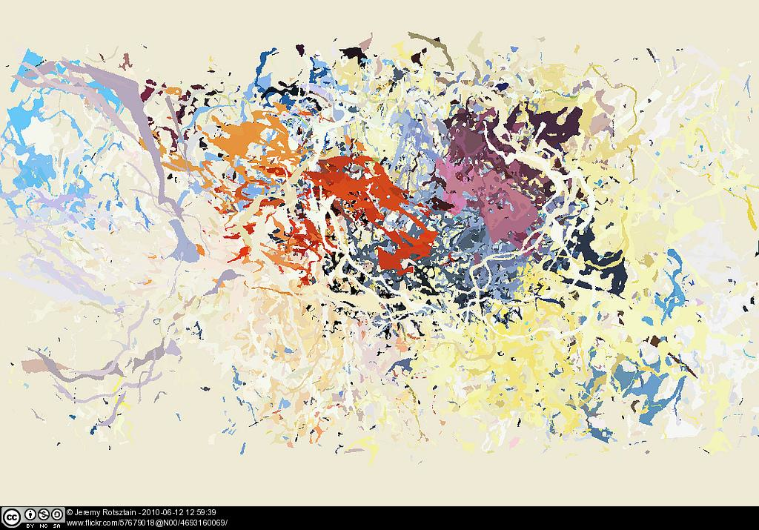
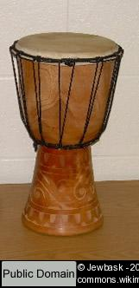
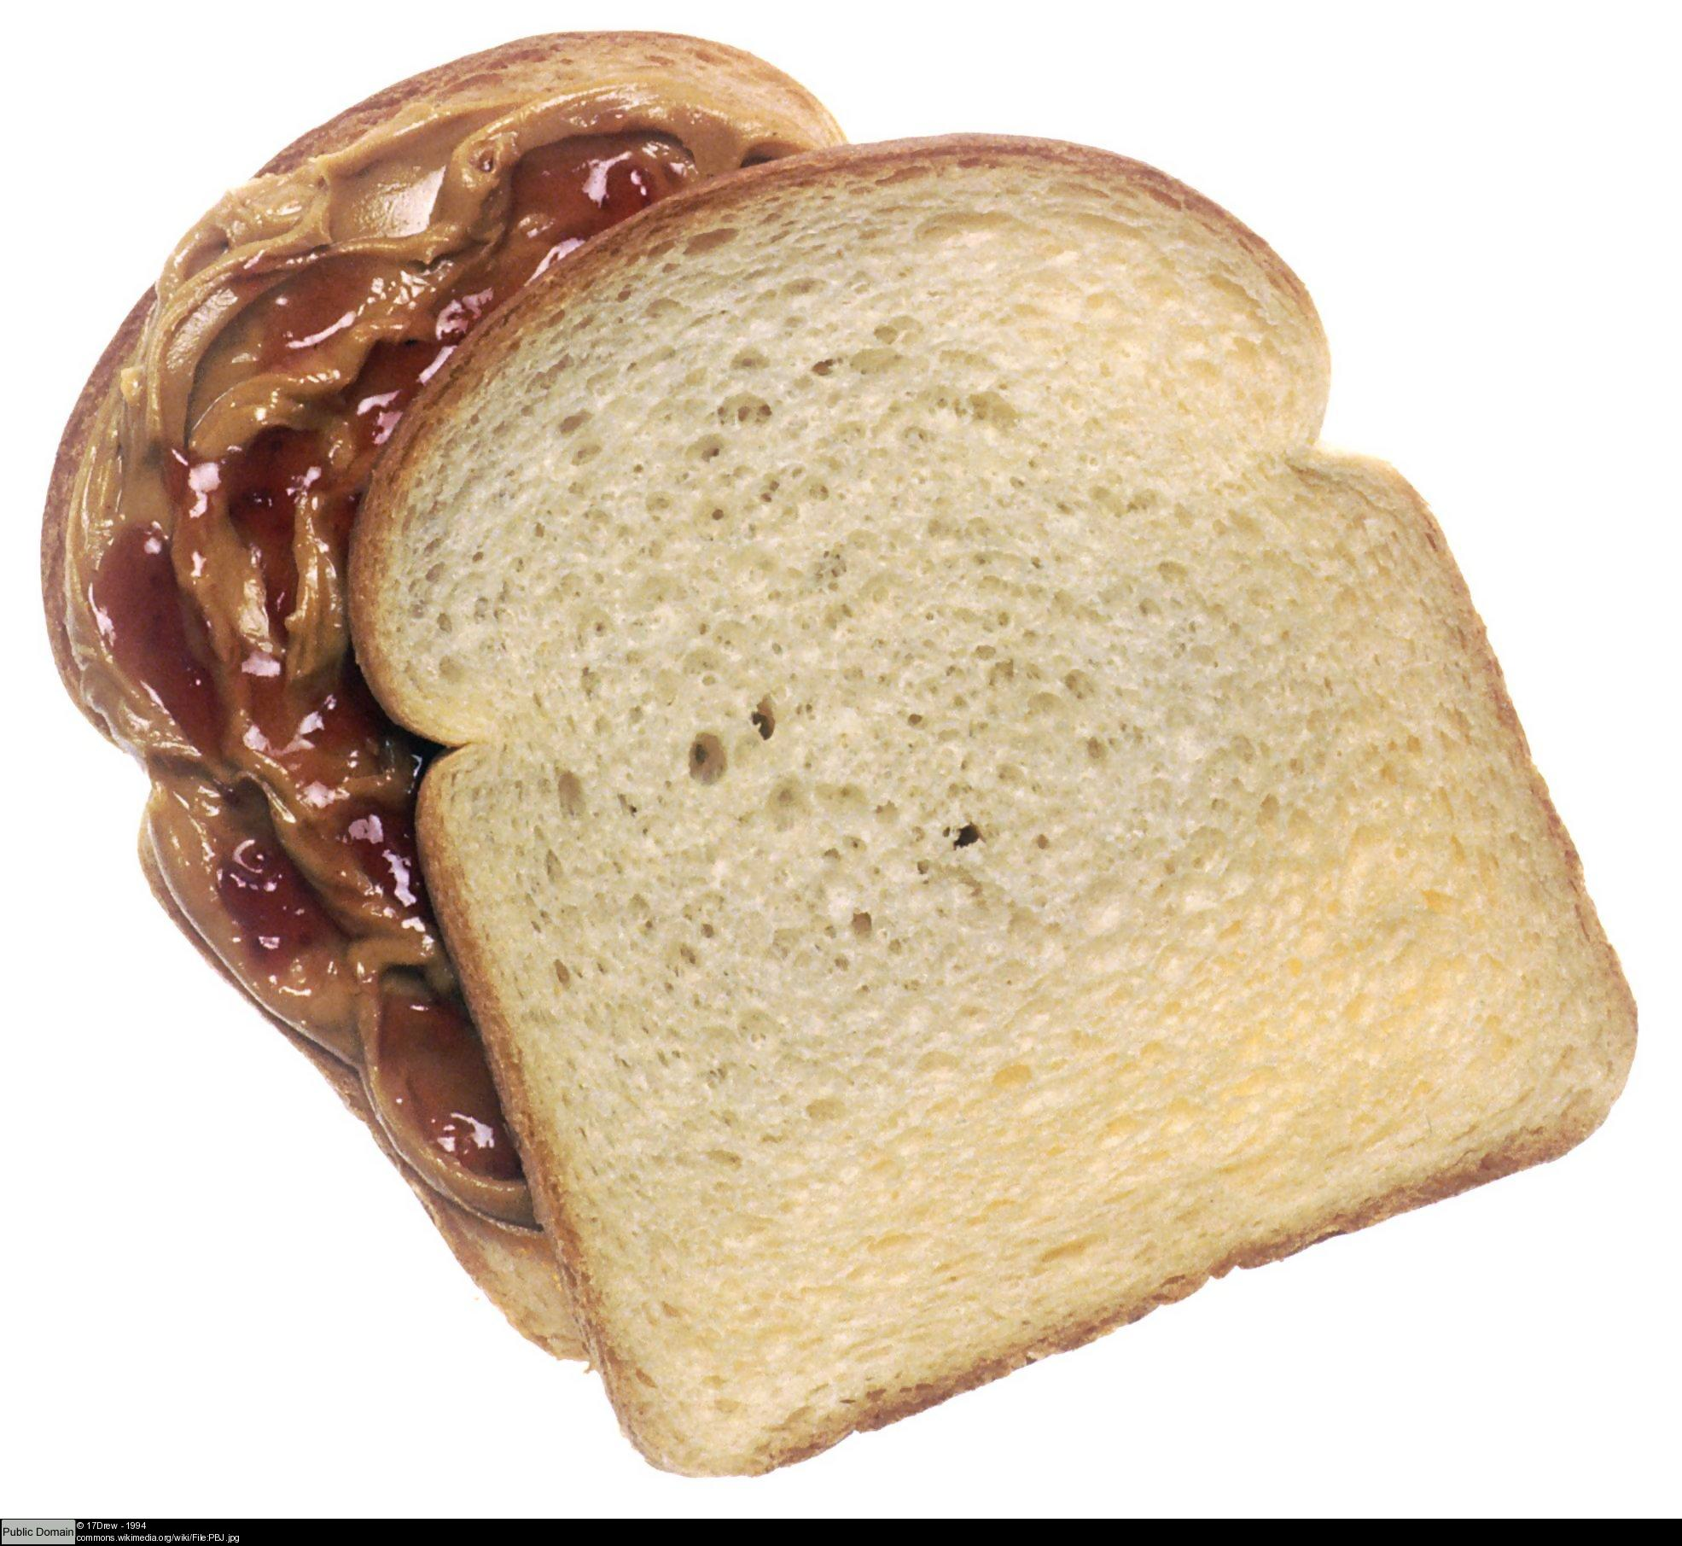

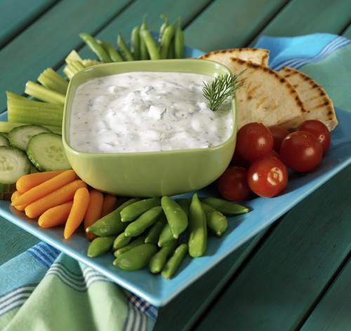
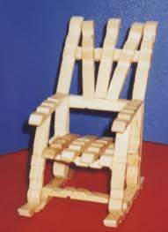

Slide 26
Treatment
Use of free
time
Social
ability
Occupational
Performance
Area’s
Personal
Management
Treatments are skill
based
Self differentiation
Self presentation
Passive participation
Work
Ability
Notes:
GO through the colours again-
Self differentiation- toddler- 121 treatments on the ward- blue
Self presentation- school age- most of the patients-yellow
Passive participation- young teenagers- people nearer to discharge- green
The four occupational performance areas as outlined by the model of creative ability
Use of free time; planning and structuring the day
Personal management; personal care, bed space, finances
Work ability; an activity with an end product, so not work, could be taking the children to school or cooking a meal
Social ability; communication and interaction skills

Slide 27
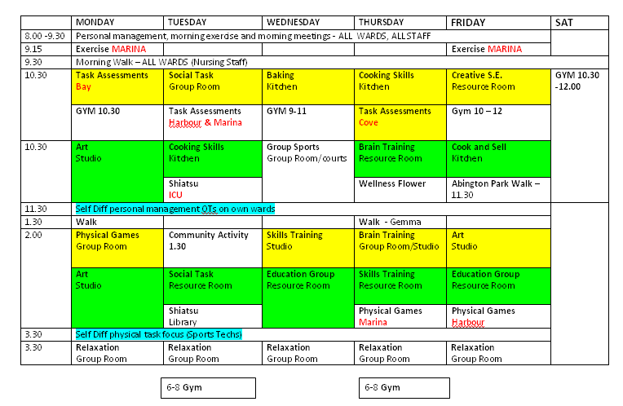
Weekly Timetable
Notes:
Typical weekly timetable
A yellow and green session most mornings and afternoons. The white sessions are open to anyone and are relaxation and physical activities.
We are able to do self differentiation/blue 121’s on our own wards
Morning meeting- allowing to plan and facilitate structuring the day

Slide 28
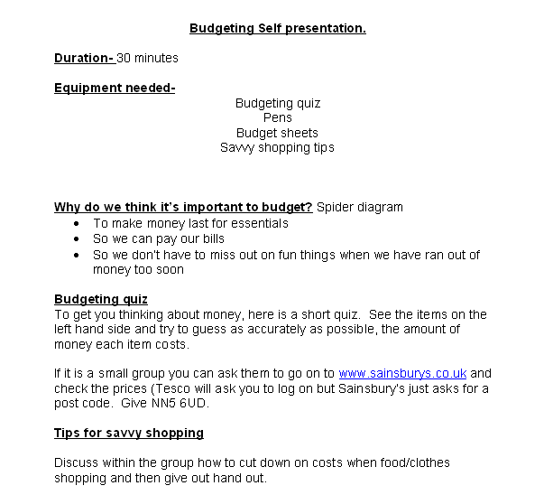
Self presentation skills session budgeting
Improve self esteem and decrease anxiety
Improve social awareness and communication
Improve acceptable behaviour
Experience fun and enjoyment
Notes:
Introducing the group
Teaching boundaries and social norms but not necessarily expecting concordance with this
On the left you have the session plan- the group will last for about 25-30 minutes and has a practical focus
On the right;
Improve self esteem and decrease anxiety by making finances manageable
Improve social awareness and communication via group discussion
Set boundaries and expectations to improve acceptable behaviour
Experience fun and enjoyment

Slide 29
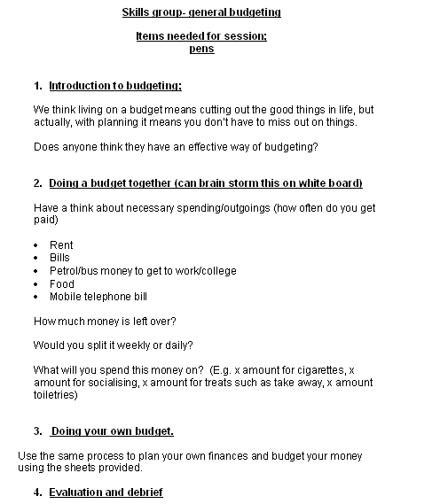
Passive participation skills session budgeting
Improve personal management
Improve knowledge and skills
Improve socialisation
Improve self esteem
Improve work habits
Notes:
Introduction to group; give our expectations of behaviour in the group and encourage that. For example if someone wanted to go for a cigarette half way through a session I would be encouraging them to stay in the group.
On the left you have the group outline;
Discussing the importance of budgeting
Doing a general monthly budget (abstract) as a group
Facilitating and supporting them to do their own budget
On the right; treatment aims;
Improve personal management- in terms of community survival
Improve knowledge and skills
Improve socialisation through group discussion
Improve self esteem- working independently to manage finances
Improve work habits- planning and organising

Slide 30
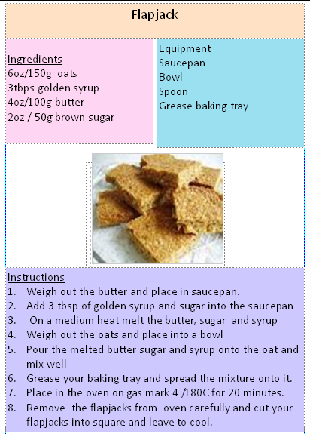
Self presentation cooking skills
Improve self esteem (flop proof)
improve communication/social awareness
Improve acceptable behaviour/social norms
Improve basic tool handling
Improve awareness of effect of self on environment
Experience fun and enjoyment
Notes:
Introduction to group- teaching social norms but not expecting them to adhere to them.
Flap jacks;
8 steps, structure environment, take some of the steps away, work in pairs
On the right; treatment aims;
Improve self esteem (flop proof)
Work in pairs to improve communication/social awareness
Introduce group by explaining expectations to improve acceptable behaviour/social norms
Improve basic tool handling
Improve awareness of effect of self on environment
Experience fun and enjoyment

Slide 31
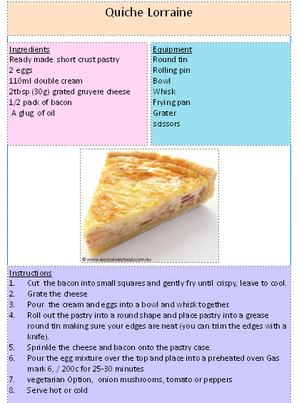
Passive participation cooking skills
Improve domestic aspect of personal management
Improve knowledge and skill
Improve socialisation
Improve self esteem
Improve work habits
Notes:
Again, introduce the group with social norms and expected behaviours
On the left;
Recipe for making a quiche Lorraine. We choose meals such as soups, pasta meals that use everyday ingredients that the patients can afford
On the right; treatment aims;
Improve domestic aspect of personal management (in charge of own work space)
Improve knowledge and skill for product
Improve socialisation by working within a group
Improve self esteem by making an edible product
Improve work habits (planning and organising)

Slide 32
Outcome measures
Link to the
PbR
Creative
Participation
Tool
Activity
Participation
Outcome
Measure
Weekly reviews
Notes:
Creative participation tool after each treatment session
Feeds in to the weekly reviews so we can see change in functioning each week. We are now linking this to the clustering/ HONOS so hopefully after a few months we should be able to provide data to show peoples cluster and the OT treatments they require for a safe discharge.
APOM- we did this on admission and we complete this again upon discharge to measure over all change in a persons functioning from admission to discharge.
Right, that is the end of my presentation, hopefully you will have all gained some understanding of the adult acute inpatient service here at the berry wood, a very brief overview of the model of creative ability and how we use it in our OT care pathway here at the Berrywood. There will be some time for questions in a minute but if you would like to know further details on the model you can visit the website on the next page.
Thank you

Slide 33
References:
De Witt, P. (2005). Creative Ability- a model for psychiatric occupational therapy. In Crouch, R. & Alers, V.(eds). Occupational Therapy in Psychiatry and Mental Health. 4th Ed. London and Philadelphia: Whurr Publishers.
http://www.modelofcreativeability.com/what-is-macaig.html

