Slide 1

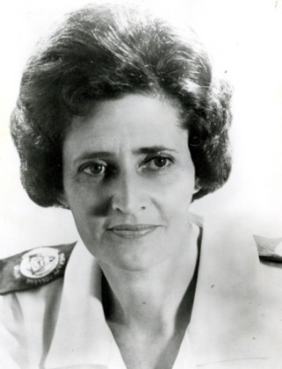

The Vona du Toit
Model of Creative Ability
(VdT MoCA)
Wendy Sherwood MSc DipCOT
VdT MoCA Foundation (UK)
www.vdtmocaf-uk.com wendysherwood@vdtmocaf-uk.com
International Creative Ability Network (ICAN)
(training provider www.ican-uk.com wendy@ican-uk.com 07870 646509)
Senior Lecturer in OT, London South Bank University
www.modelofcreativeability.com

Slide 2
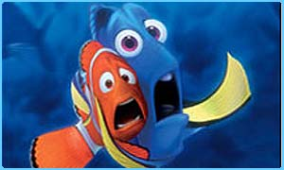
A sophisticated, intelligent model, but also
very understandable and logical

Slide 3

Creative and creativity
In doing there is creativity
Creative: to bring into existence something that did not exist before to the person creating it
Creation: tangible and intangible
Notes:
What does it take to create something? Motivation and ability / action

Slide 4

Materials
Environment
Objects
Occupation, activities, tasks
People
Mind, body, drive/motivation, spirit
Situations

Slide 5

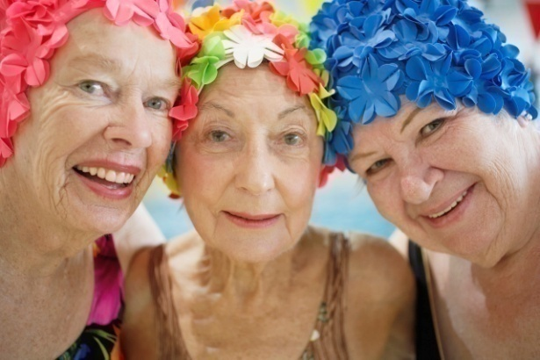

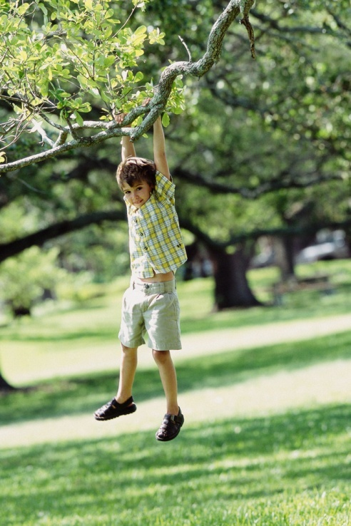
Mind
Body
Drive
Motivation directs behaviour / action (mental and physical effort)
What the person participates in, and the way that the person participates in the world (activity participation) indicates:
the person’s motivation
the person’s knowledge and skills (occupational performance)
Combined = [creative] ability
Levels of…………
Notes:
?? Do you talk about levels????
Pool Activity levels – Claudia Allen
MOHO – not levels, but scores – FAIR
What is a person motivated for?
How do you know?
What do you do?

Slide 6
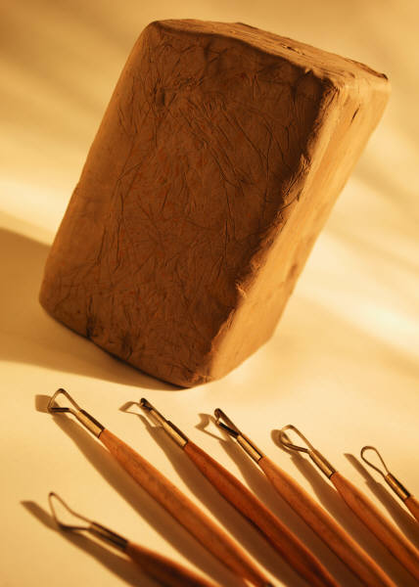
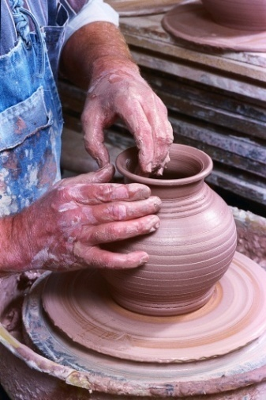
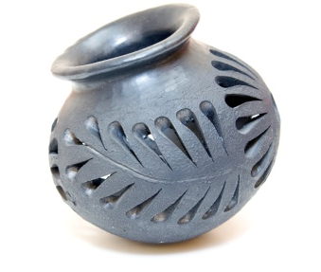
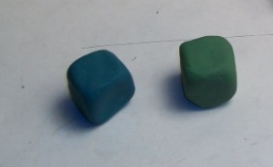
Motivation and ability in action
Response:
Prepared to exert effort
Participation
Product: as a result of mental and physical effort
Connect with
materials, objects, people and situations
Use of materials and tools (objects), relate to people, manage situations
Concept formation (understanding ‘things’), Task concept (understand and able to do a task to completion)
Behaviour, initiative and effort, norm awareness + compliance, control of anxiety and emotional responses
Supervision/support, product
Notes:
The way that the person responds, participates and creates a product is what identifies the person’s level of creative ability.

Slide 7
MOTIVATION
ACTION
ACTIVE PARTICIPATION: To at least meet standards if not improve upon them; not being exactly the same, but having own ideas and doing things in a new way . | ORIGINAL: Increasingly self-assured and acts on own initiative; tries out use of materials/objects in new ways. Tries different roles in a group and in situations; leadership qualities emerge.
IMITATIVE PARTICIPATION: DOING THINGS PROPERLY | IMITATIVE: Focused on producing products and behaviours to expectations/norms; doing as well as others . Independent. Maturity in relationships develops; compensates for others.
PASSIVE PARTICIPATION: Wanting to do and be with others; learn rules and social expectations - HOW TO BEHAVE AND DO THINGS PROPERLY (to norms/expectations) | EXPERIMENTAL: focused on creating a quality tangible end product ; Understands tasks start to finish and can do them; self evaluation begins. Uses tools reasonably well. Experiments with materials, objects etc in order to extend knowledge. Participates in wider variety of situations.
SELF-PRESENTATION: To develop a sense of self: WHAT I LIKE AND WHAT I CAN DO and to show this to others ; try activities and find out - enquiry | EXPLORATIVE: Intentional exploration of everything including people and activities; the pursuit of gaining knowledge is a key focus. Partial ability to comprehend and do tasks effectively and independently; lacks skills; effort not maintained.
SELF-DIFFERENTIATION: To differentiate self from the environment - who and what am I? - What are things around me? | DESTRUCTIVE: able to recognise some things but no / limited understanding of what they are/what they are for, therefore contact with things is often unrelated to actual function or properties of objects/materials; no planning; fleeting awareness of people. Becomes incidentally constructive in action
TONE: Appears to be motivationally ‘blank’. Existence. | PRE-DESTRUCTIVE: Appears purposeless/haphazard: lying on bed unresponsive to stimuli or walking around in a wandering way ; no planned action. No material or object handling.
Notes:
What activity?

Slide 8

Assessment, intervention and outcome
Notes:
OTAs lead on this.

Slide 9
Motivation and ability in action
Response:
Prepared to exert effort
Participation
Product: as a result of mental and physical effort
Connect with
materials, objects, people and situations
The way that the person responds, participates and creates a product is what identifies the person’s level of creative ability.
The assessment is therefore mainly observation of activity participation and relating to MOPS – activity focused assessment, plus interview

Slide 10



Assessment
Know the person – who is he/she?
How has he/she become who they are? What is his/her life about?
Observation
- observation / information from others
Interview
Assessment of doing an unfamiliar activity (task assessment)
Social evaluative group
Roles
Routines
Interests
Values
Skills

Slide 11
Motivation and ability in action
Response:
Prepared to exert effort
Participation
Product: as a result of mental and physical effort
Development or recovery of ability requires activity participation, therefore activity focused intervention
The response-participation-product process has to be facilitated and supported through understanding and providing the conditions necessary to elicit motivation and enable participation
Notes:
= treatment principles

Slide 12
SELF-DIFFERENTIATION: To differentiate self – who and what am I? - What are things around me? | DESTRUCTIVE: able to recognise some things but no / limited understanding of what they are/what they are for, therefore contact with things is often unrelated to actual function or properties of objects/materials; no planning; fleeting awareness of people.
AIMS??
Notes:
Students identify activities – 5 minutes

Slide 13
SELF-DIFFERENTIATION: To differentiate self – who and what am I? - What are things around me? | DESTRUCTIVE: able to recognise some things but no / limited understanding of what they are/what they are for, therefore contact with things is often unrelated to actual function or properties of objects/materials; no planning; fleeting awareness of people.
AIMS: Become involved in activity Increase understanding about self, objects Attempt relating to people Develop focusing of attention
Treatment guide??
Activity that ………..?
Notes:
Students identify activities – 5 minutes

Slide 14
SELF-DIFFERENTIATION: To differentiate self – who and what am I? - What are things around me? | DESTRUCTIVE: able to recognise some things but no / limited understanding of what they are/what they are for, therefore contact with things is often unrelated to actual function or properties of objects/materials; no planning; fleeting awareness of people.
AIMS: Become involved in activity Increase understanding about self, objects Attempt relating to people Develop focusing of attention
Activities?
Notes:
Students identify activities – 5 minutes

Slide 15
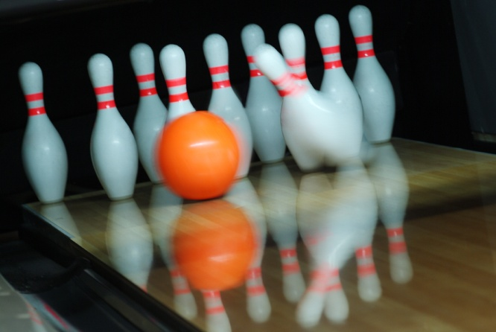
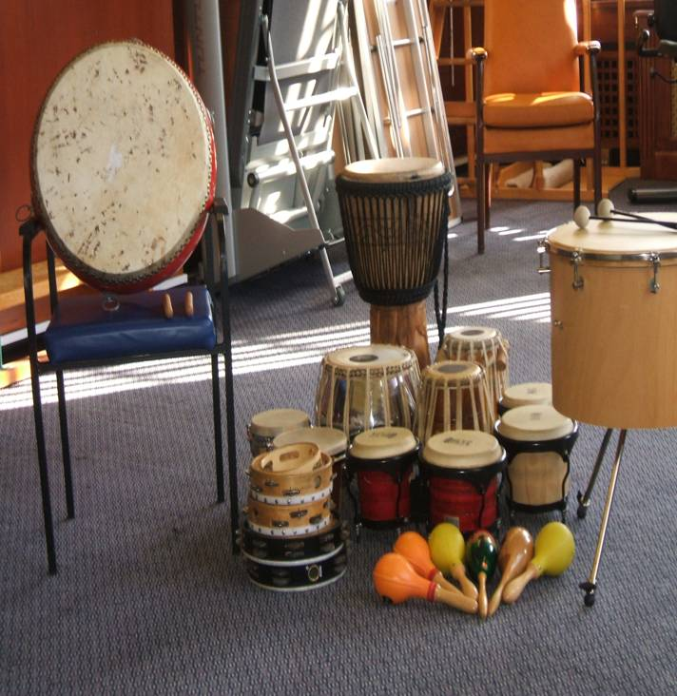
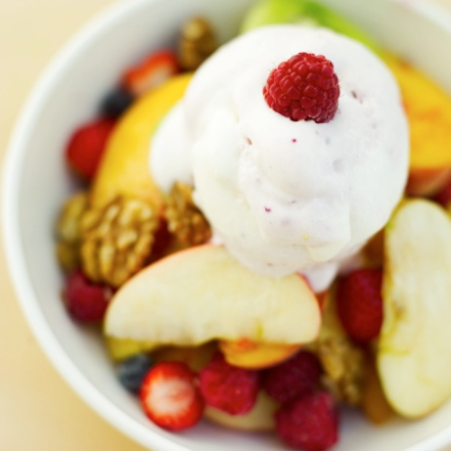

Activity requirements:
1-2 step activity
no intellectual demands (e.g. planning)
immediate / quick gratification (in less than 5 mins)
can be repeated
no / very basic tool handling
no fine coordination, but movement
sensory stimulation
destructive to incidentally constructive
stimulates an emotional response

Slide 16
SELF-DIFFERENTIATION: To differentiate self – who and what am I? - What are things around me? | DESTRUCTIVE: able to recognise some things but no / limited understanding of what they are/what they are for, therefore contact with things is often unrelated to actual function or properties of objects/materials; no planning; fleeting awareness of people.
AIMS: Become involved in activity Increase understanding about self, objects Attempt relating to people Develop focusing of attention
Treatment principles = how to achieve the aims
Activity requirements:
1-2 step activity
no intellectual demands (e.g. planning)
immediate / quick gratification (in less than 5 minutes)
can be repeated
no / very basic tool handling
no fine coordination, but movement
destructive to incidentally constructive
Handling: Emphasise individuality
Structuring: Use individual and small group settings
Presentation: Give direction about what to do
Notes:
Students identify activities – 5 minutes

Slide 17

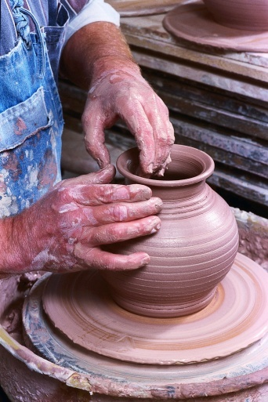

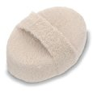

Self presentation
Passive
Self differentiation
Imitative/active
Tone
Notes:
I don’t know of any other model that does this. Understanding the needs and skills in levels, and selecting activity for therapy accordingly is reflected in the changes made to OT programmes and ward service provision

Slide 18
Summary
Theory of creative ability (creation of oneself): recovery of self
Ability focused
Sequential levels of motivation and action
Guide to identify level, elicit motivation and enable change through mastery of challenges: occupation focus

Slide 19

www.modelofcreativeability.com www.vdtmocaf-uk.com

Slide 20

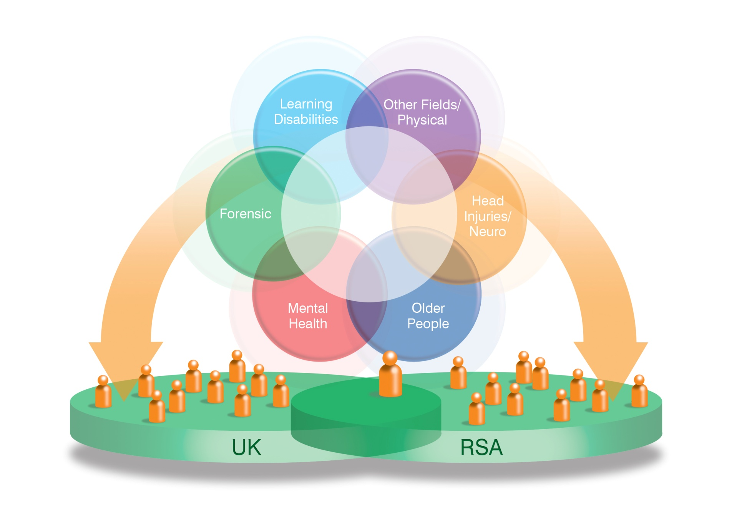

VdT MoCA Foundation (UK) and the Model of Creative Ability Interest Group
www.modelofcreativeability.com
Aiming for an internationally solid network of practitioners and educators that share knowledge and resources; support each other and work together for the benefit of the model, the OT profession and clients
JAPAN

Slide 21
The Vona du Toit
Model of Creative Ability
(VdT MoCA)
Wendy Sherwood MSc DipCOT
VdT MoCA Foundation (UK)
www.vdtmocaf-uk.com wendysherwood@vdtmocaf-uk.com
International Creative Ability Network (ICAN)
(training provider www.ican-uk.com wendy@ican-uk.com 07870 646509)
Senior Lecturer in OT, London South Bank University
www.modelofcreativeability.com

Slide 22
SELF-PRESENTATION: To develop a sense of self: WHAT I LIKE AND WHAT I CAN DO and to show this to others ; try activities and find out - enquiry | EXPLORATIVE: Intentional exploration of everything including people and activities; the pursuit of gaining knowledge is a key focus. Partial ability to comprehend and do tasks effectively and independently; lacks skills; effort not maintained.
Aims:
Improve self esteem, decrease anxiety
Improve social awareness + communication
Improve basic tool handling
Improve awareness of effect of self on environment
Activity requirements:
3-4 steps
Lends itself to exploration (different colours, tools, materials, OPTIONS)
Allows for basic tool handling
Flop proof
Quick gratification (within one session)
Encourages social communication and interaction

Slide 23
